Slide 1
Citrus Circuits
Fall Workshop Series
Promoting DE&I
by Kayla Lee & Olivet Yettou
Notes:
Hello, thank you for coming to our fall workshop presentation.
I hope you’re in the right classroom since we’ll be presenting about promoting DE&I

Slide 2
Table of Contents
Definition of dei
Why it’s important
Car air bags - everyone contributing -> society for all
Talk about our own team - show our percentages (growth)
What we do to encourage it
Recruitment - trying to reach a broad audience
Lgbtq+ rep (new position)
Wise
Robocamps wise week
Girl scout tours
Bonding nights
Disteminar
Citrus for change
What can your team do? First steps to be more diverse
Targeting recruitment
recruitment night for minorities (dec)
We go to english classes as well
Putting flyers in places of hispanic communities, get flyer in spanish (not doing this yet)
Being diverse is not about having a certain percentage of each group
Your team should reflect your community
Racial
Gender
Socioeconomic
Accessibility

Slide 3
Wistem - 2014 first event
Series of women panelists at dmg mori conference room
Citrus for change - 2020
Alternative logo designs: buttons, shirts
Fundraisers
Lgbtq+
Partner w/ lgbtq+ in first community
2018: wistem -> distem
Broader inclusivity efforts

Slide 4
What is DE&I?
Diversity:
“the practice or quality of including or involving people from a range of different social and ethnic backgrounds and of different genders, sexual orientations, etc.” (Oxford Languages)
Inclusion:
“the practice or policy of providing equal access to opportunities and resources for people who might otherwise be excluded or marginalized, such as those who have physical or intellectual disabilities and members of other minority groups.” (Oxford Languages)
Equity:
"Recognizes that each person has different circumstances and allocates the exact resources and opportunities needed to reach an equal outcome.” (George Washington University)

Slide 5
What is DE&I?
Diversity
“The practice or quality of including or involving people from a range of different social and ethnic backgrounds and of different genders, sexual orientations, etc.” (Oxford Languages)
Inclusion
“The practice or policy of providing equal access to opportunities and resources for people who might otherwise be excluded or marginalized, such as those who have physical or intellectual disabilities and members of other minority groups.” (Oxford Languages)
Equity
"Recognizes that each person has different circumstances and allocates the exact resources and opportunities needed to reach an equal outcome.” (George Washington University)

Slide 6
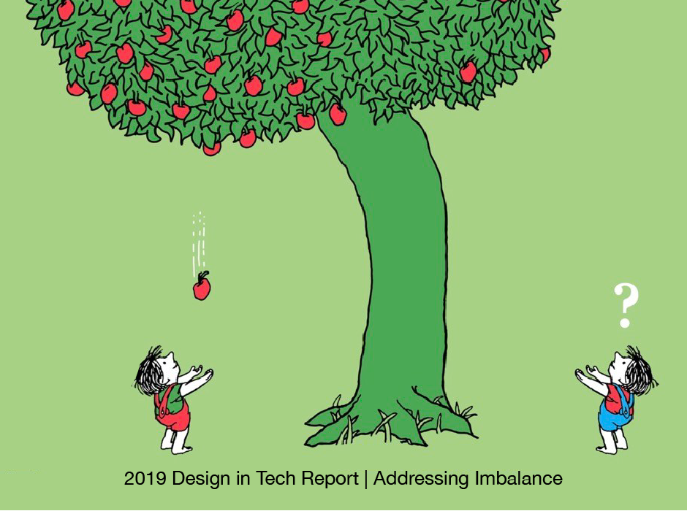
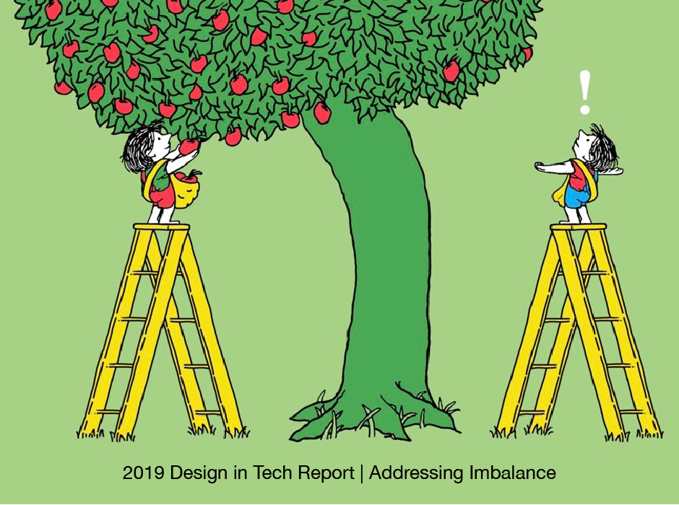
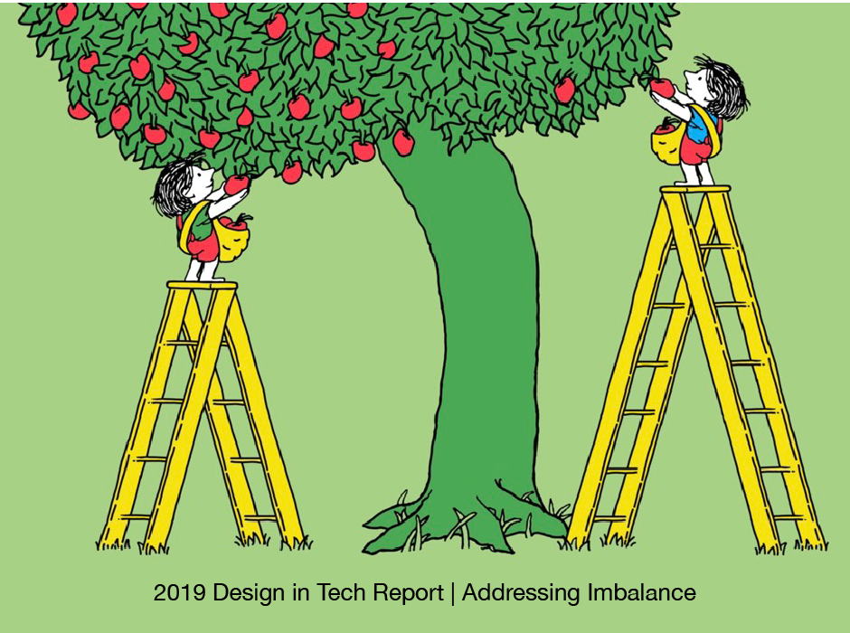
Equality vs Equity
Wistem - 2014 first event
Series of women panelists at dmg mori conference room
Citrus for change - 2020
Alternative logo designs: buttons, shirts
Fundraisers
Lgbtq+
Partner w/ lgbtq+ in first community
2018: wistem -> distem
Broader inclusivity efforts
Notes:
Inequality equality equity

Slide 7
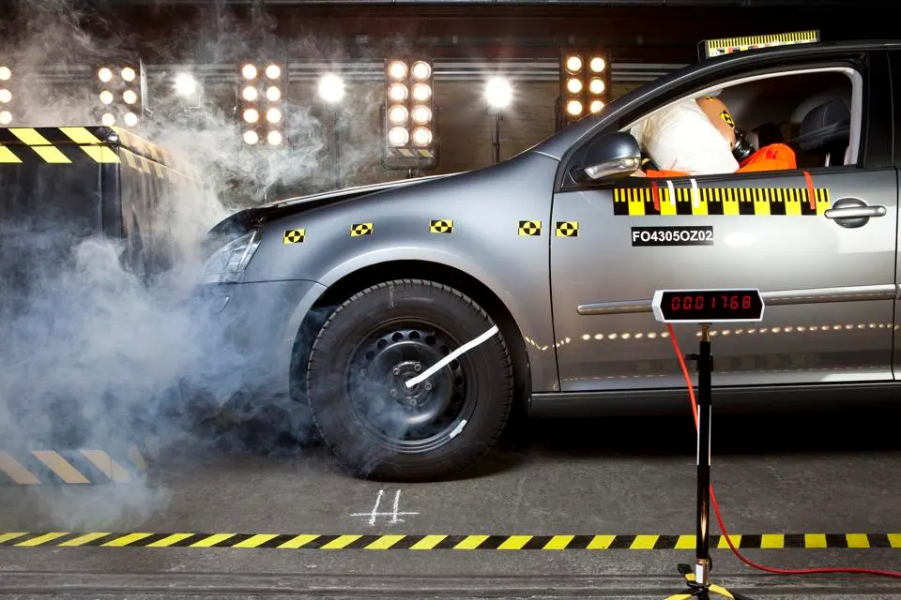
Why is this important?
Everyone should contribute for a society for all
Notes:
Women are the majority of the drivers and are historically less likely to get into a crash than men are, but
Women are 17% likely to die in a car accident and 73% more likely to sustain serious injuries from a crash than men
Women are more likely to die/get injured in a car crash
1960s-70s: had actual people do car crash tests (men because people believed that men were more likely to die in car accidents compared to women)
Dummies replaced live test subjects - limited funds to make only male dummies
Continuing up to now as female dummies aren’t required in car crash tests
Sweden made a female dummy for the first time (2023) - previously have been slimming it down instead of reflecting body mass differences
But it’s not just men and women we need to focus our attention on; it’s tall people and short people, bigger people and smaller people, people with disabilities,
To make a society for everyone—make it safe for everyone—we need everyone’s input

Slide 8
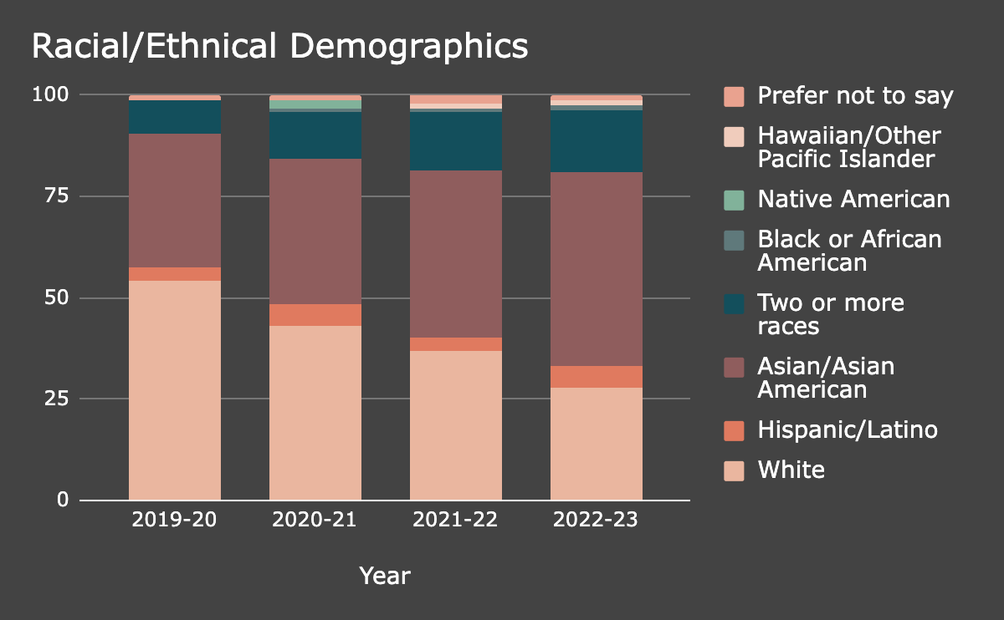
Our team
Notes:
Davis demographics
White - 50%+
Asian - 20%+
Hispanic/Latino - 13.8%
African America - 2%+
Native American - 1%
Hawaiian/Pacific Islander - less than 1%
Multiracial - less than 2%
Before I talk a little bit about our team’s diversity, I feel like it’s important to bring up our town, Davis’ demographics. Davis is a predominantly white community. More than 50% of the population is Caucasian

Slide 9
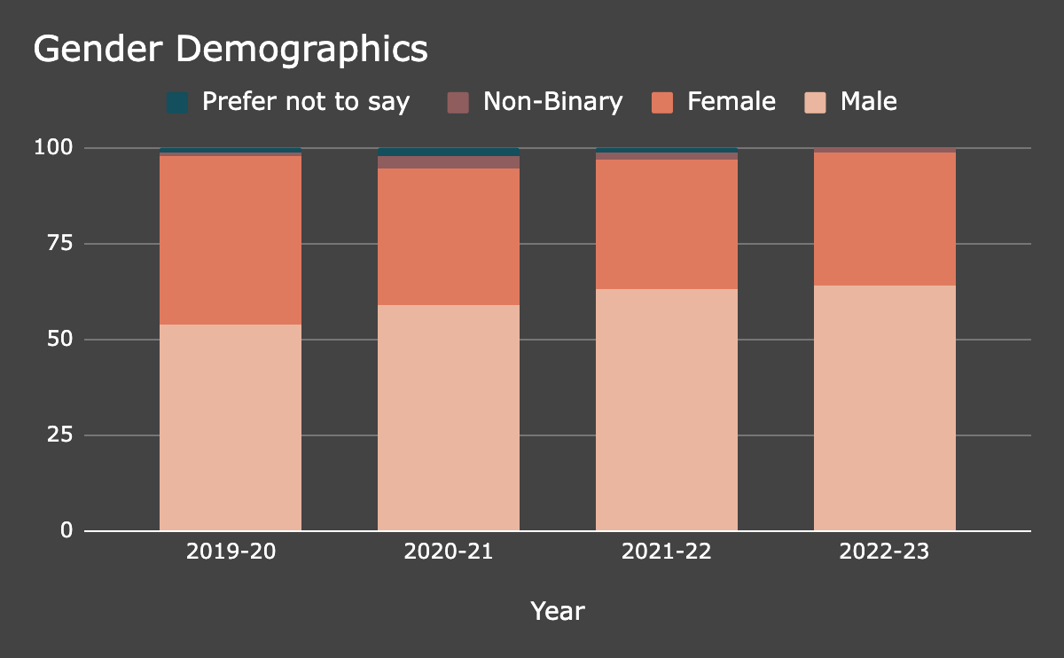
Our team
Notes:
Growth in team diversity will go here if the stats look ok

Slide 10
Our DiSTEM History
WiSTEM (Women in STEM) founded 2014
First event: women STEM panel
2018: WiSTEM changed to DiSTEM (Diversity in STEM)
Dec 2018 - started WiSE (Women in STEM Empowerment) events
Wistem - 2014 first event
Series of women panelists at dmg mori conference room
Citrus for change - 2020
Alternative logo designs: buttons, shirts
Fundraisers
Lgbtq+
Partner w/ lgbtq+ in first community
2018: wistem -> distem
Broader inclusivity efforts
Notes:
WiSTEM (Women in STEM) founded 2014
First event: women STEM panel
2018: WiSTEM changed to DiSTEM (Diversity in STEM)
To expand to more groups of underrepresented people (broader inclusivity efforts)

Slide 11
What we do
Recruitment
Reaching out to all middle schools in the area
Within the team
Bonding Night
DiSTEMinar (Diversity in STEM Seminar)
Reducing financial barriers
Youth program scholarships
Covering travel expenses
Notes:
Presentations in English classes: Mandatory for all students → reaches a broader audience
Instead of science classes, where students can choose to take or not (in our district)
DiSTEMinars
Invite STEM professionals to share their experiences with team members
Women in STEM Seminars, Racial Diversity in STEM Seminars
Through these seminars, we’re planning to hear the experiences of more diverse people
Robocamps & League scholarships

Slide 12
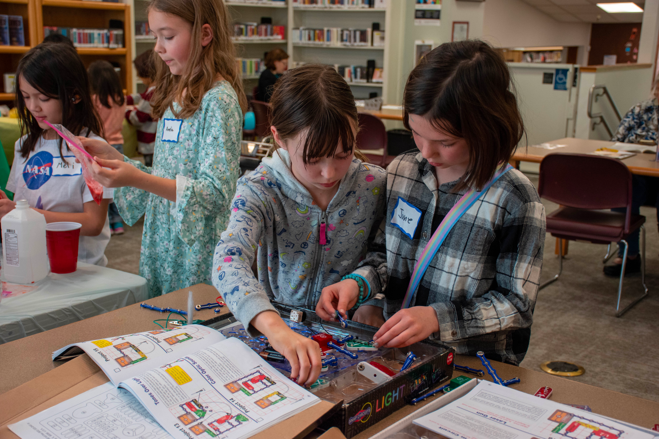
WiSE: Women in STEM Empowerment
Designed to inspire young girls 3rd-8th grade
WiSE Robocamps week
Girl Scout tours at Sac Regional
Expanding to neighboring communities
Notes:
Wise events: STEM activities organized by 1678 volunteers - fun experiments like acid/base volcano
Explain the science behind it
Chose libraries to do them because it’s a place for learning experiences
Explain robocamps before going into wise robocamps week
Expansion - Dixon, Fairfield - reaching a broader audience
Recognize Davis is a predominantly white area - have been doing events outside to reach a diverse community

Slide 13
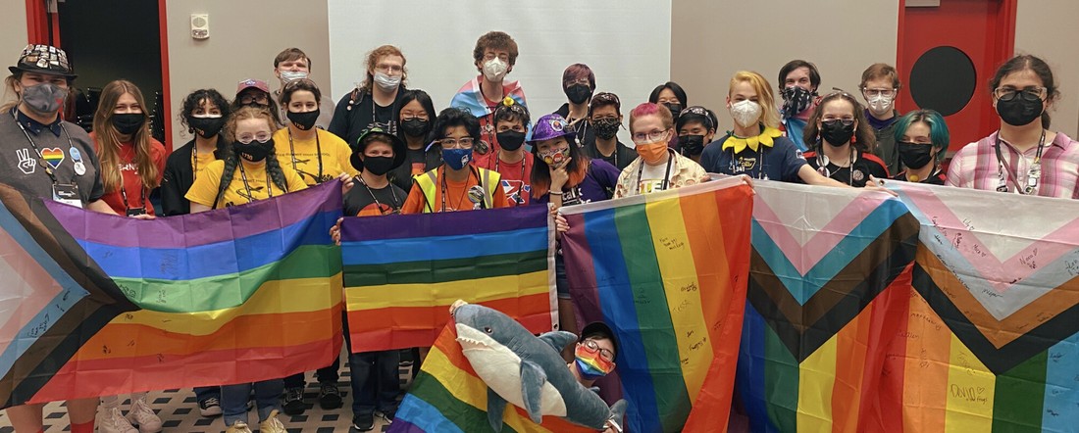
Supporting the LGBTQ+ Community
LGBTQ+ of FIRST
Partnership began in 2021
Bronze Tier
Notes:
LGBTQ+ of FIRST is a student run organization that seeks to create a safe and educated space for LGBTQ+ students, mentors, and volunteers of FIRST Robotics

Slide 14
LGBTQ+ Community Outreach
Pride month posts
Highlighting notable LGBTQ+ people in STEM
Pride robot-demos
Davis Phoenix Coalition
Notes:
Phoenix Coalition: community org thats goal is to eliminate intolerance by engaging and uniting community to prevent hate. Have done things like hosted pride festivals, youthgroups, workshops for spanish speaking immigrant mothers

Slide 15
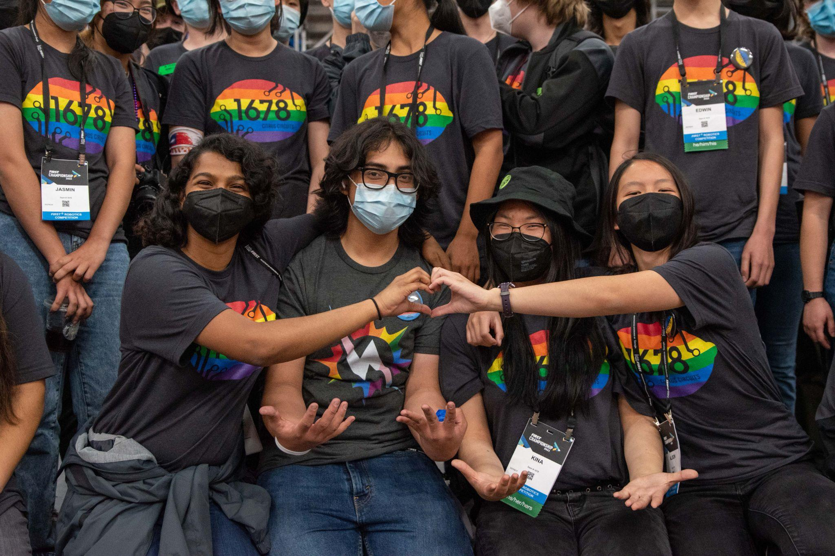
LGBTQ+ Outreach Within the Team & FRC
Pride shirts
Rainbow flag, Trans flag
Partnering with other teams
Inclusive discussions
Bonding nights
Pronouns
Pins
Slack Profiles
Notes:
LGBTQ+ round table discussion w informational kahoot and cake

Slide 16
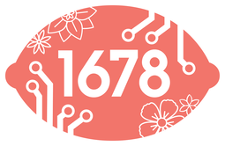
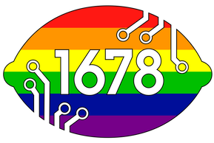
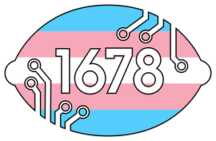
Citrus For Change
2021
2020
2021
2021
2022
2022
2022
Notes:
Citrus for change - 2020
Explain what it is
Alternative logo designs: buttons, shirts
Fundraisers to show support in causes our members are interested in
Sold blm shirts, pride stickers - donated to
NAMI Yolo (we partnered with) (mental health)
Contact respective chapter for resources and learn how to support peers
Asian Americans Advancing Justice (aapi)
Sacramento LGBT Community Center (pride)
(ask bam for time frame)
Black - black lives matter 2021
Green ribbon - mental health awareness 2021
Pink - aapi 2021
Rainbow - pride 2020 (original) 2022? (now)
Blue, yellow - ukraine 2022
Blue, pink, white - transgender 2022
Red flower - reproductive rights movement 2022

Slide 17
What can we do to make our teams more inclusive?
Start within the team:
Organize a bonding night
Target recruitment
Where is the most accessible place in your community?
Support causes team members are interested in
Participate in community events
Reach out to community groups
Use social media

Slide 18
What else can we do?
Feel free to share your ideas.
Wistem - 2014 first event
Series of women panelists at dmg mori conference room
Citrus for change - 2020
Alternative logo designs: buttons, shirts
Fundraisers
Lgbtq+
Partner w/ lgbtq+ in first community
2018: wistem -> distem
Broader inclusivity efforts

Slide 19
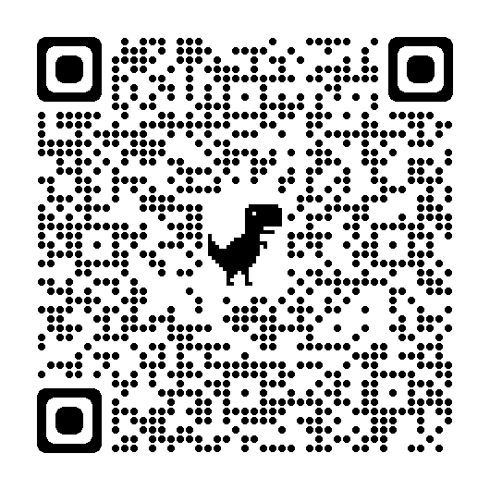
Survey!
We’d love to hear how your team promotes DE&I: https://forms.gle/DtCWnr84j7vgULDk8
Wistem - 2014 first event
Series of women panelists at dmg mori conference room
Citrus for change - 2020
Alternative logo designs: buttons, shirts
Fundraisers
Lgbtq+
Partner w/ lgbtq+ in first community
2018: wistem -> distem
Broader inclusivity efforts
Notes:
Form on how participants’ teams foster dei

Slide 20
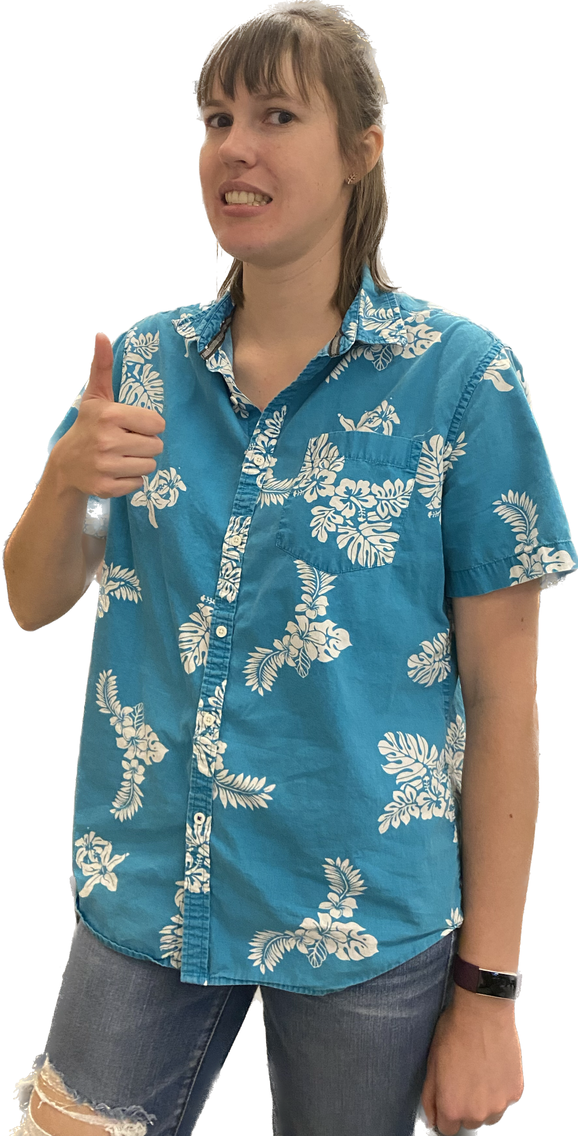
“Being diverse is not about having a certain percentage of each group. Your team should reflect your community.”
Jenn

Slide 21
Resources
LGBTQ+ of FIRST https://lgbtqoffirst.weebly.com/
NAMI https://www.nami.org/findsupport
Visit our website: https://www.citruscircuits.org/
Hotlines:
Trevor project: (866) 488-7386
Suicide and Crisis Lifeline: 988
Online chat: (800) 203-8255
Trans Lifeline: (877) 565-8860
Wistem - 2014 first event
Series of women panelists at dmg mori conference room
Citrus for change - 2020
Alternative logo designs: buttons, shirts
Fundraisers
Lgbtq+
Partner w/ lgbtq+ in first community
2018: wistem -> distem
Broader inclusivity efforts

Slide 22
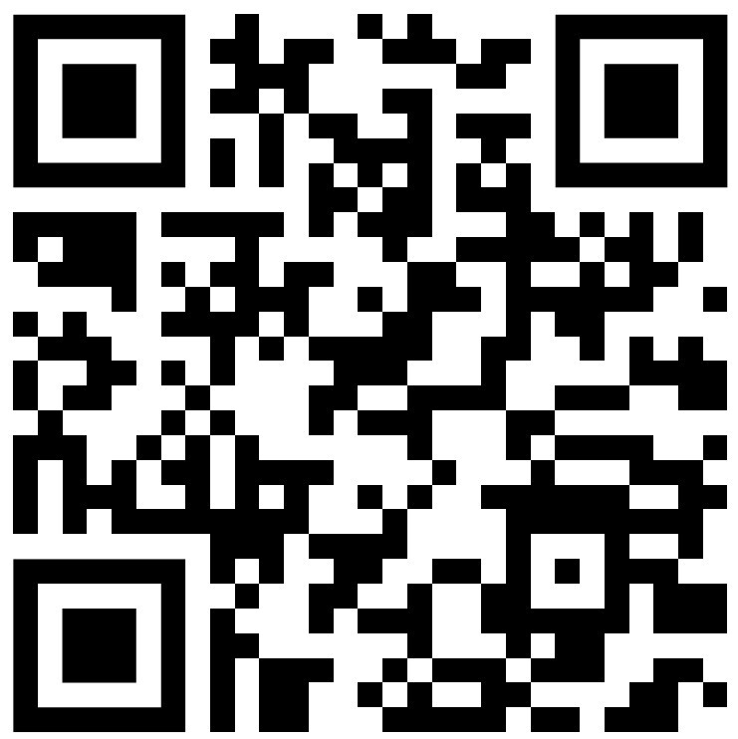
We’d love to get your feedback!
Fall Workshop Post-Event Survey
Notes:
Our workshop is Diversity in STEM

Slide 23
Citrus Circuits
Fall Workshop Series
distem@citruscircuits.org
Thank you, and please join our LGBTQ+ gathering from 8 to 9 pm!
Notes:
And please join the other workshops tomorrow!

