Slide 1
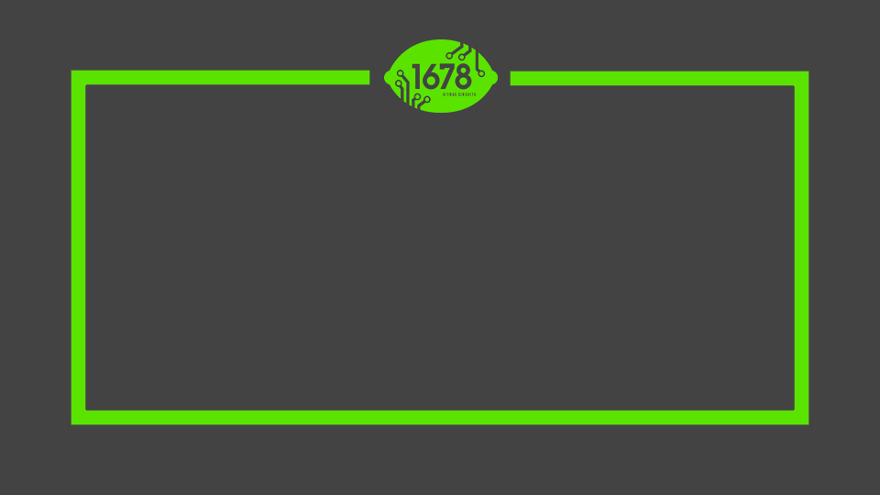
Citrus Circuits
Fall Workshop Series
Effective Driving
by Yi Zhang

Slide 2

outline

Slide 3
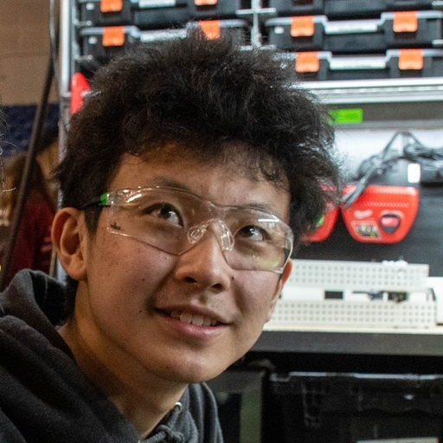
Who Am I?
Yi Z.
  H.S. Senior
  Software Robot Lead and Base Driver
  3rd Year Driving

Slide 4
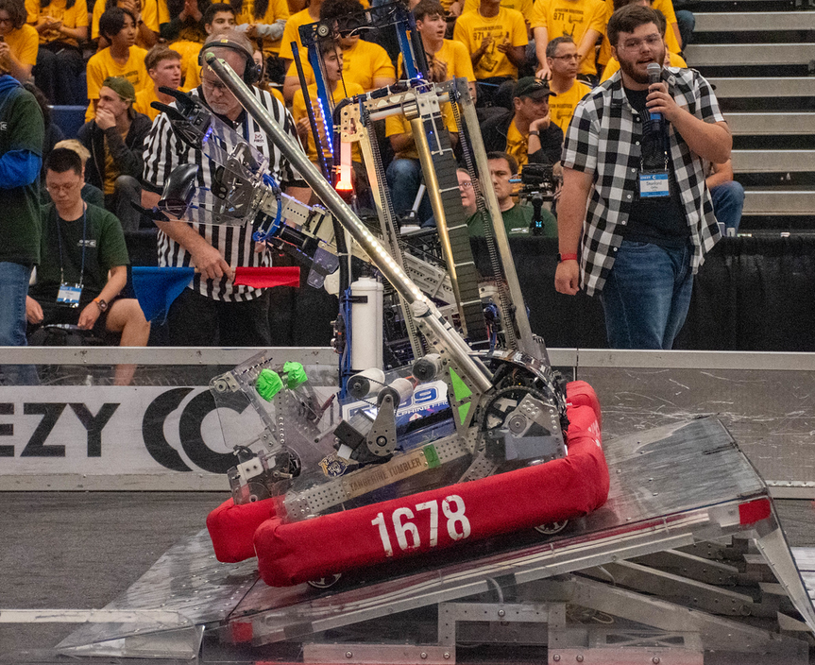
Outline
Outline
Why is driving important?
How to practice
  Before season
  In season
Competition
Example match review

Slide 5
Why driving?
Having a capable robot is only part of the battle
Driving is vital to getting the most performance out of your robot
29 out of the 32 teams in playoffs on Galileo we scouted in the top 32 for driver ability

Slide 6
Pre-Season

Slide 7
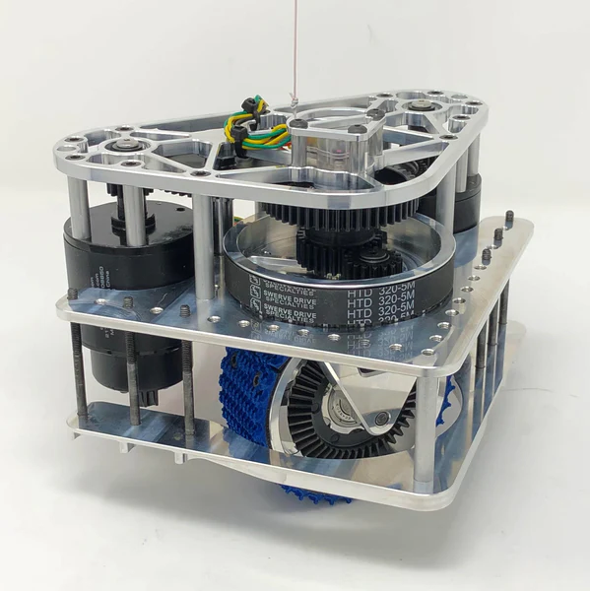
Pre-Season Prep
Pick a permanent drive team
  Available time, maturity, and communication skills
  Robot knowledge helps
Go to offseason competitions
Build a swerve drive

Slide 8
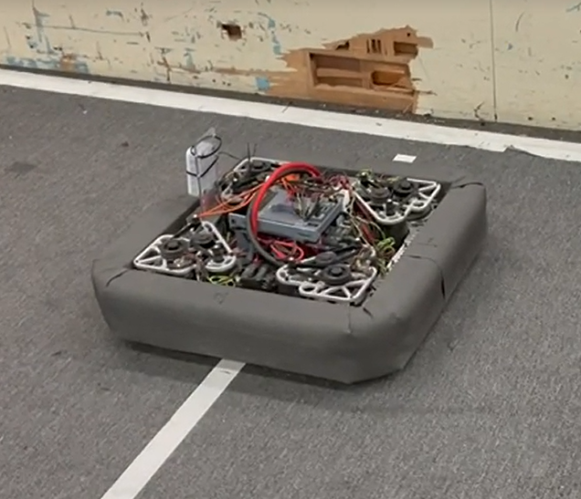
Pre-Season Prep. Cont
Keep an old drivebase
  Run drivebase drills
Watch matches from top teams!

Slide 9
Recommended watching
1690 Chezy Champs 2021 - Swerve Anti-Defense
973 Chezy Champs 2021 - Tank Linear Offense
973 Sacramento 2022 - Tank Circular Offense
1577 Einstein 2022 - Hybrid Offense/Defense
498 Chezy Champs 2022 - Swerve Defense
5940 Monterey Bay 2023 - Swerve Linear Offense
2910 IRI 2023 - Swerve Linear Offense

Slide 11
Build Season

Slide 12
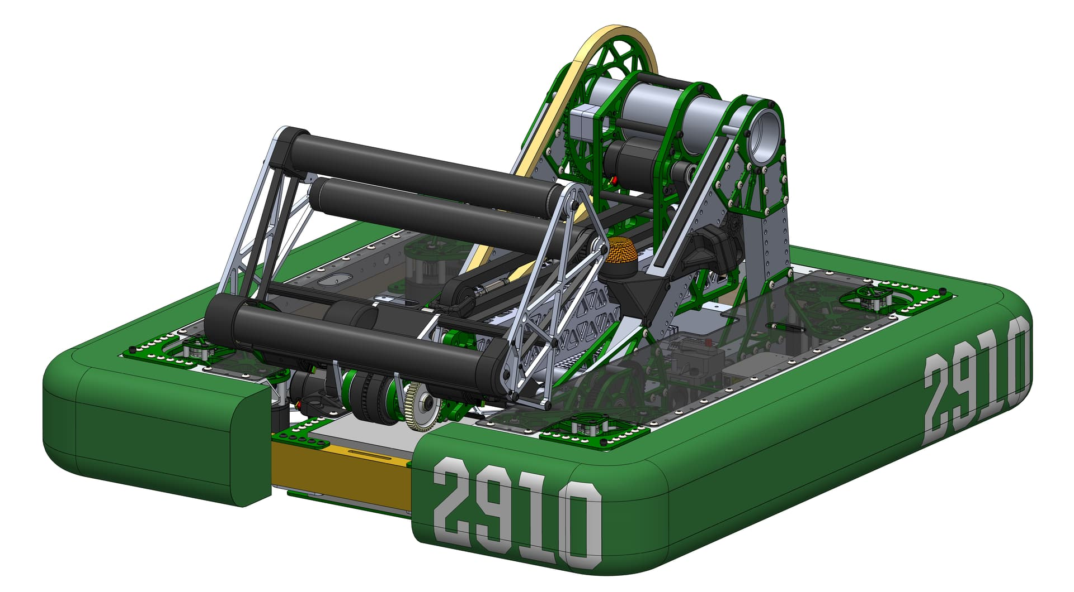
Step Zero
Build a robot that’s drivable
Low CG
Easy acquisition zones
Centering Intake
(Optional) Automation

Slide 13
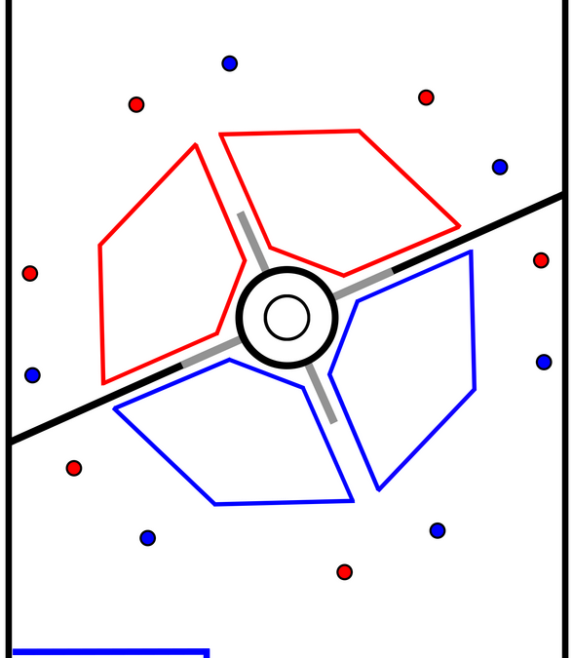
Callout Plan
Standardize names for important locations
Entire drive team should agree on naming
Examples:
  2021 Trench/Rendezvous
  2022 Clock system
  2023 Grid numbering
12
9
3
6

Slide 14
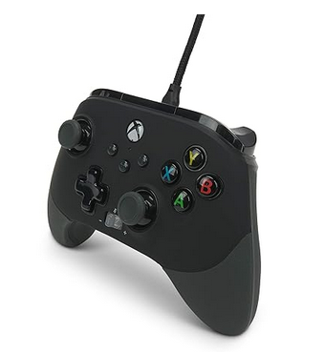
Control Scheme
Use a high quality gamepad
Work with software and drive team to come up with a button map
Try to keep thumbs free to stay on joysticks
Probably dial down your rotation stick sensitivity
Operator is more flexible, use whatever works for you

Slide 15
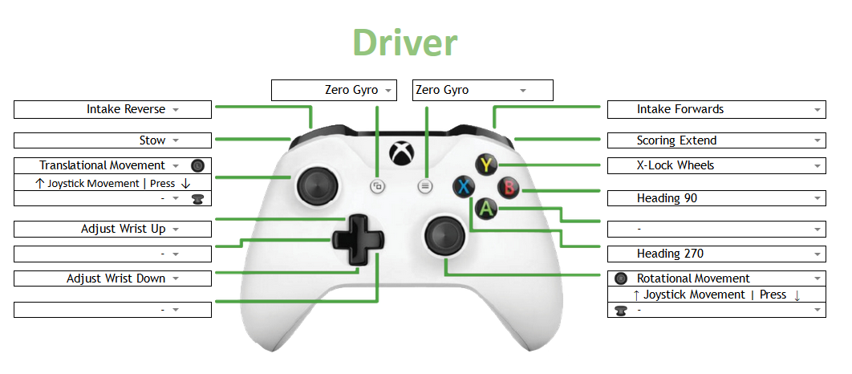

Slide 16
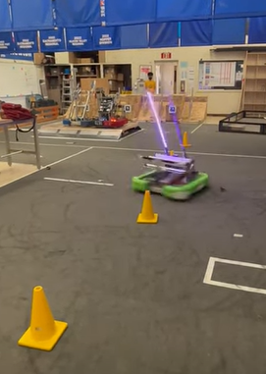
Designing Drills: Drivetrain
Focus on getting comfortable controlling the drivetrain
Start slow and smooth, speed up gradually over time
Turning while moving is super important

Slide 17
Example Drills: Drivetrain
Chair drill
  Put chair on field, drive in circles around chair with one side of the robot tracking the chair
  Should be one continuous motion, no stopping and starting
Cone Slalom
  Make rows of cones
  Weave in between cones while spinning robot

Slide 18
Designing Drills: Key Actions
Identify key actions in game
  2022: Picking up cargo
  2023: Loading from substation, placing game pieces, picking up game pieces from midfield
Good drills should be:
  Isolated
  Time limited
  Scorable
Don’t be afraid of breaking the robot!

Slide 19
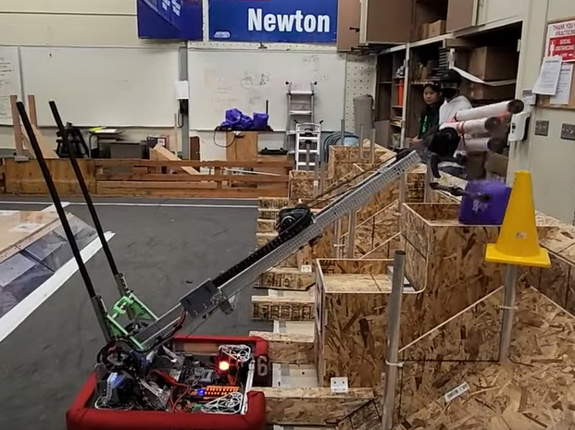
Running Drills: Key Actions
Use field elements to align when you can
Write down scores for every run
  Video is even better
Start slow and smooth, speed up gradually
  No “choppiness”

Slide 20
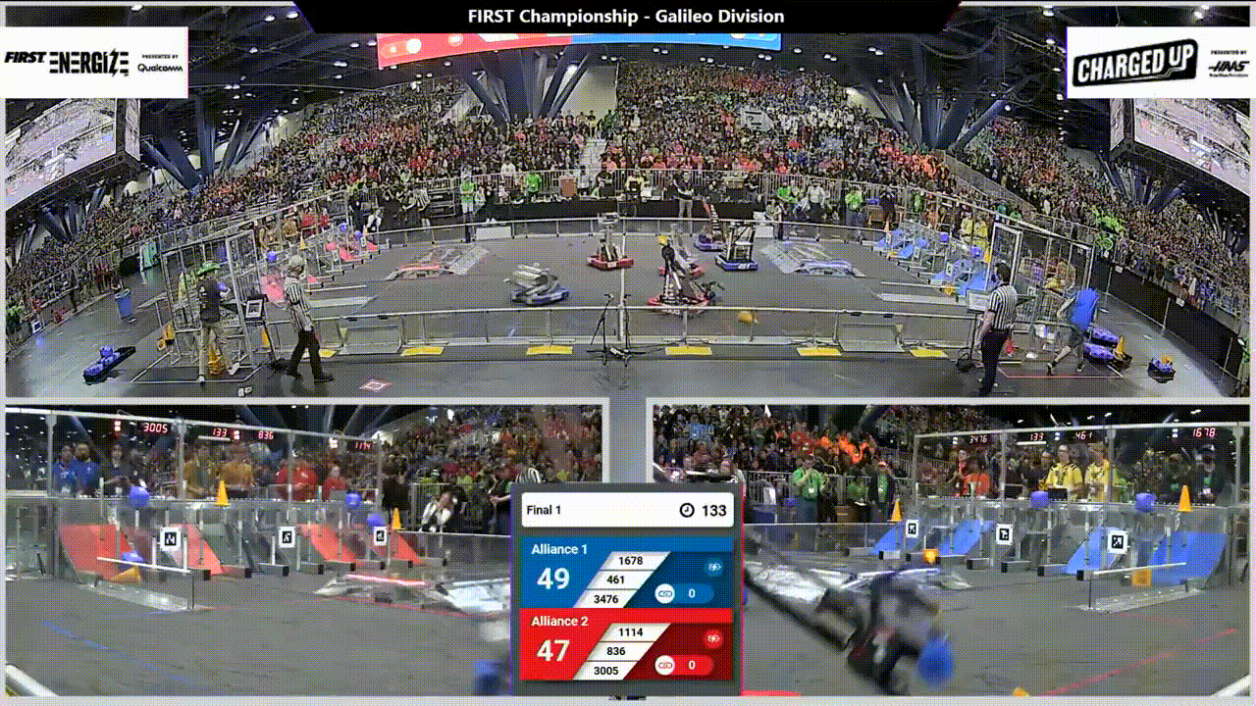
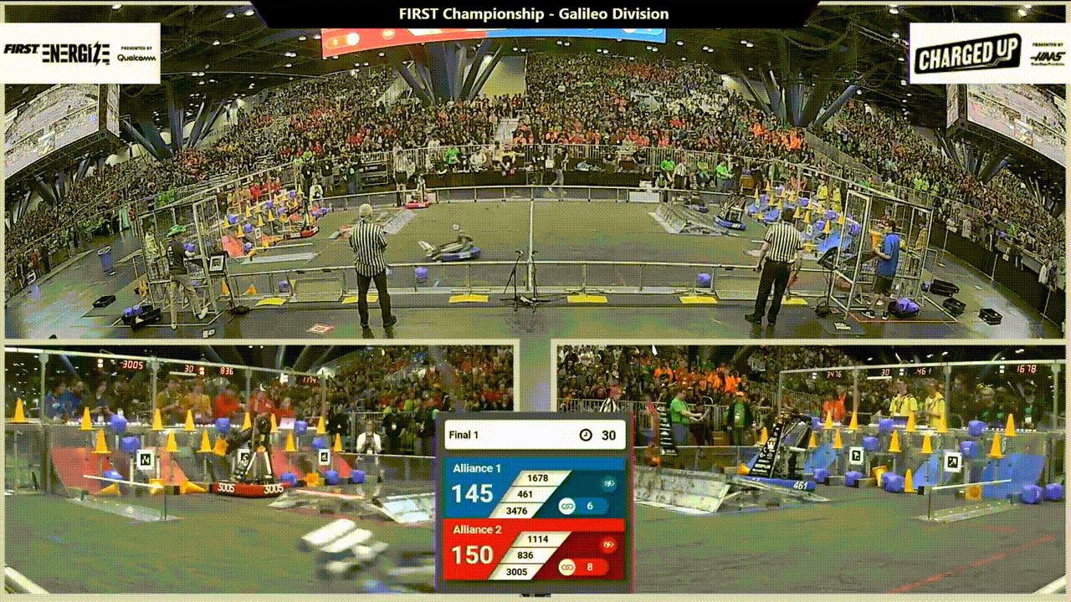

Slide 21
Example Drills: Game Specific
Charged Up 2023
  Pick up and score the four auto starting game pieces as quick as possible
  Intake from human, score as many pieces as possible in X seconds
Rapid React 2022
  Pick up game pieces in preset locations as fast as possible
  Score as many game pieces as possible in X seconds, only picking up cargo that drive coach calls out.

Slide 22
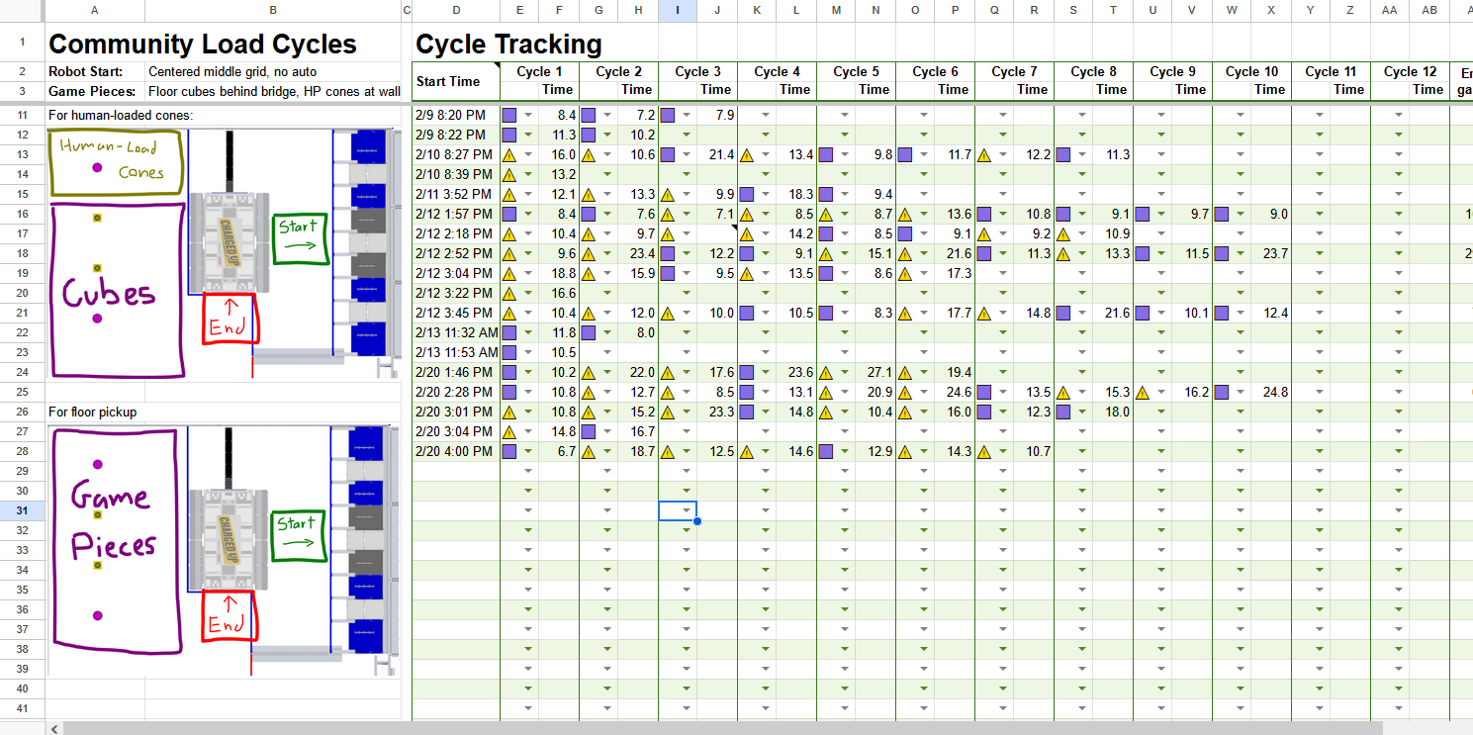

Slide 23
Match Simulation
Running simulated matches is immensely helpful
Include all sections of a match (auto, tele, endgame)
Don’t be afraid of breaking the robot
Track scores and record any robot failures that happen
Run defense matches with last year’s drivebase

Slide 24
Competition

Slide 25
Pre-Match
Have someone coordinate strategy before your match
Review with alliance partners while in queue
Make sure all 3 teams are on the same page for what to do
Having a strategy board helps
A good match should be boring

Slide 26
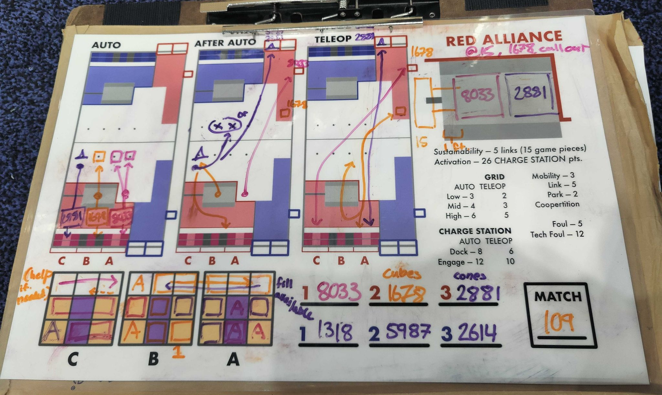

Slide 27
In-Match
Focus on staying calm
  Don't worry about match results
Don't be afraid of breaking the robot
Don't be afraid to put your elbows out

Slide 28
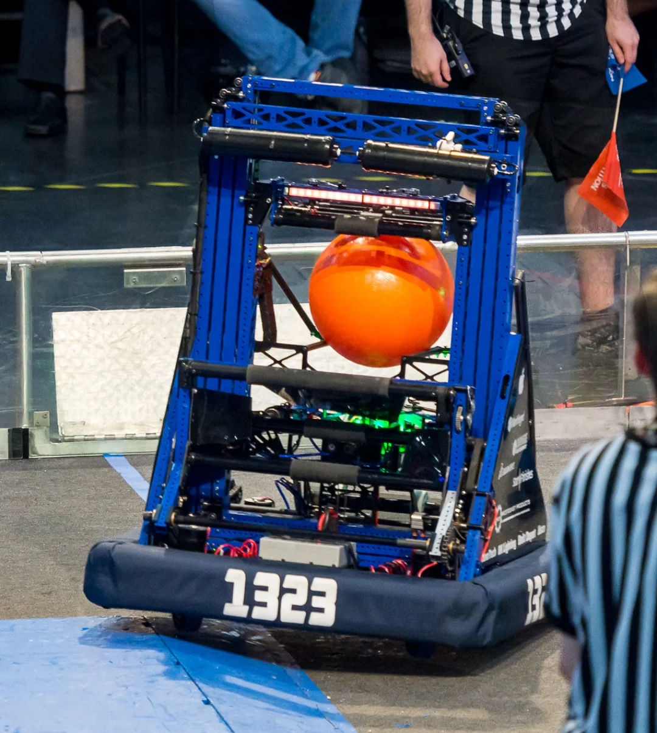
Anti-Defense
Remember to roll off robots
Minimize bumper to bumper contact
Always better to go around instead of pushing through
Throw fakes
Be wary of protected zones

Slide 29
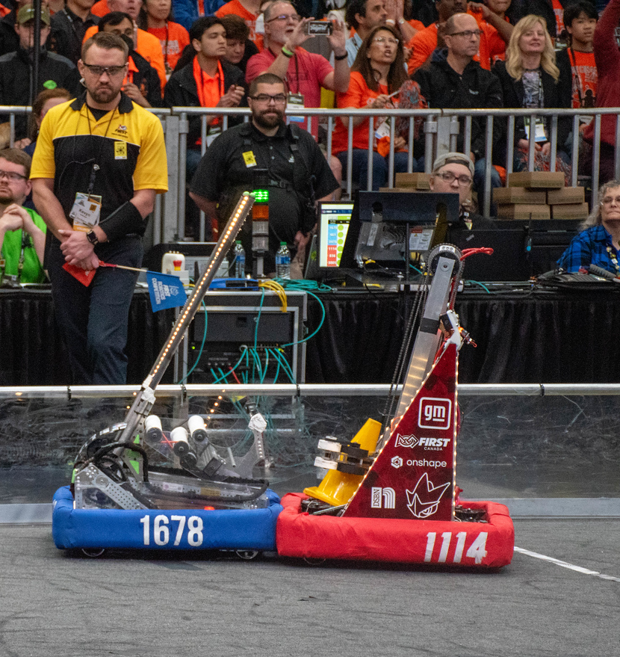
Defense
Goal is to slow down cycles, not stop a robot
Bumper to bumper time is winning
Pick your marks
Counter roll
Bait fouls
Abuse pins

Slide 30
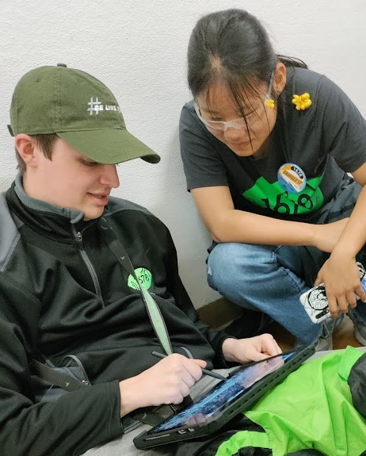
Match Review
Video matches and review with your drive team!
Overhead review is good for noting overall match flow.
Review helps de-stress the experience of driving

Slide 31
Match Reviews

Slide 32

Citrus Circuits
Fall Workshop Series
yi.zhang.yzfl@gmail.com
Thank You!

