Slide 1
Citrus Circuits
Fall Workshop Series
Strategic Design
by Austin Haddox
Notes:
Previous presentations outlined the entire process of preparing for competition
This presentation focuses on specific design objectives that will result in a simple and robust robot

Slide 2
Who Am I?
Austin Haddox
Strategy, Scouting, and Mechanical Mentor
Head of Data Analysis and Contract Management for SFCS
Going into 12th season in FRC
Started mentoring 1678 in 2019
Notes:
I have been the lead mentor of 1678 since its beginning in 2004.
I have a background in Civil Engineering but have been teaching math and robotics since 2001.
I’m married, have two children and am passionate about both windsurfing and mountain-biking

Slide 3
Overview
Pre-Season Prep
Drivetrain Design
Mechanism Design
Electrical and Pneumatics
Build Season
Competition Season
Notes:
My presentation begins with addressing the basic framework for everything we do in FIRST.
Some people use the acronym KISS but I’ve come up with my own called KISAR
Within the context of KISAR, I will discuss first drivetrain design, then mechanisms and finally electronics and pneumatics.
The last two sections discuss how the strategic design process can be effectively implemeted throughout build season and competition season
At the end of the presentation there will be a quiz and I have brought some 1678 t-shirts as prizes.

Slide 4
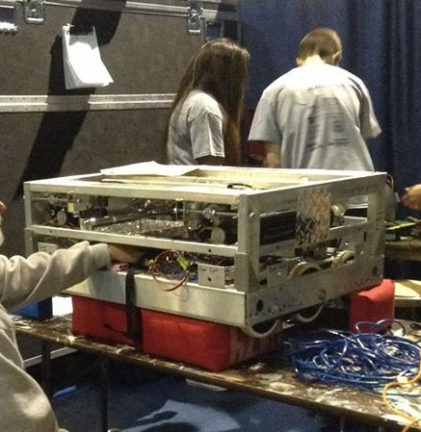
Golden Rule #1
Keep It Simple Silly
Build Within Your Team’s Capabilities
Simple = Robust
Function over Form
Notes:
I’m going to be giving you 5 golden rules. The first is Keep It Simple.
Success in FIRST is meeting you goals
Every team can set meaningful goals
Don’t over-reach
Find the simplest way to do the job
Make your robot function – doesn’t have to look pretty
(Example of 1868 at Sac Regional)

Slide 5
Pre-Season Prep
Notes:
A feature of most successful engineering designs is simplicity.
The goal in engineering is to find simple solutions to complex problems not vice versa.
In FRC, simplicity often goes hand in hand with robustness.

Slide 6
Purpose of Pre-Season
Pre-Season is not a break
Trainings
Try out new designs
Learn and research past FRC games and designs
Notes:
My presentation begins with addressing the basic framework for everything we do in FIRST.
Some people use the acronym KISS but I’ve come up with my own called KISAR
Within the context of KISAR, I will discuss first drivetrain design, then mechanisms and finally electronics and pneumatics.
The last two sections discuss how the strategic design process can be effectively implemeted throughout build season and competition season
At the end of the presentation there will be a quiz and I have brought some 1678 t-shirts as prizes.

Slide 7
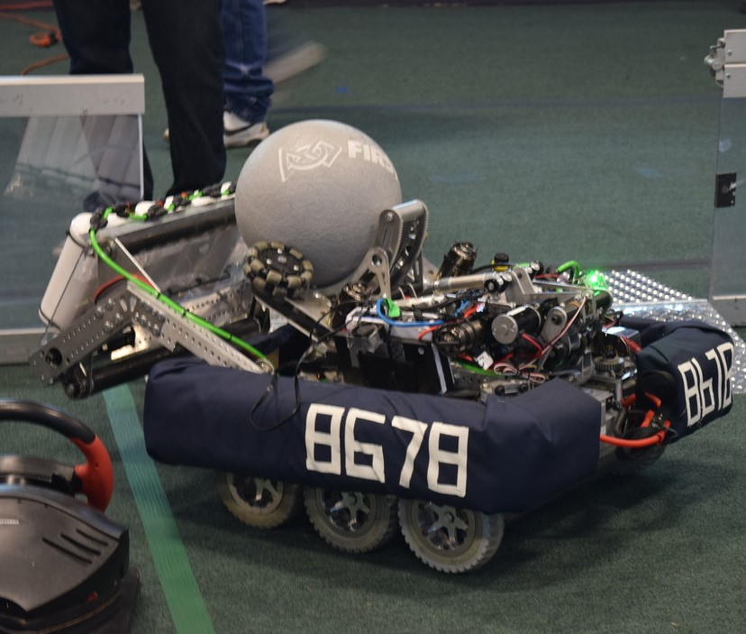
Off-Season Project Ideas
Ball Shooters
Ball Intakes
Elevators
Climbers
Kit Bot
Drivetrains
Notes:
One way to get better at building simple, robust mechanisms is to do off-season projects
Since so-many games involve shooting balls and prototyping is fairly simple this would be a good project to start with.
Elevator systems are more complex but prototyping articulating arms or other ways to elevate an object
Buy a Kit Bot from Andy Mark and practice putting it together. It can then serve as a practice bot.

Slide 8
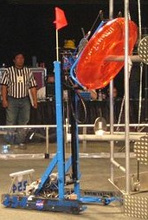
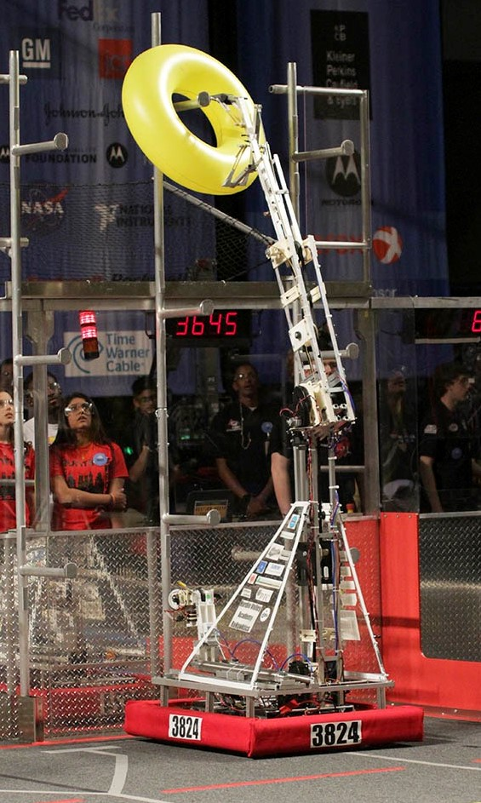
Learn Your Game History
Games often have repetition
Climbing in 2010, 2013, 2016, 2018
Tubes in 2007, 2011
Exercise Balls in 2008, 2014
Foam Balls in 2006, 2012, 2016
Flat discs in 2013, 2017, 2019
Notes:
The reason that looking back at past robots is so useful is that the features of games often get repeated.
The picture shows robots from two different games that look like they could be playing the same game.
The balls from 2006, 2012 and 2016 are very similar.

Slide 9
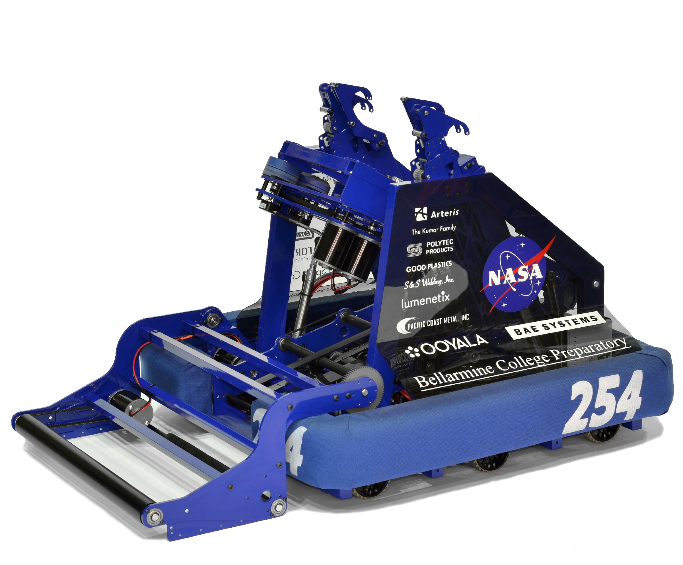
Golden Rule #2
Steal From The Best, Invent the Rest
Do Your Research
Study RI3D Teams in-season
Look at 2056, 610, 973, 330
Simple, effective robots
Notes:
The second Golden Rule is Steal From the Best and Invent the rest.
There are so many examples of great robots in FIRST
If you go back over the past 10 years, you will see solutions to many problems.
Before even starting the design process, do some research. Look at how other teams have approached the problem.
RI3D is a great way to see approaches to the new game within the first few days of build season.
You will see that the best teams build simple, robust mechanisms.

Slide 10
Drivetrain Design
Notes:
The drivetrain is the most important part of your entire robot.
Mechanisms are useless it your robot does not have good mobility.
There are a lot of teams that have issues with their drive train at competition so having a robot that has a simple, robust drive train can be a huge advantage.

Slide 11
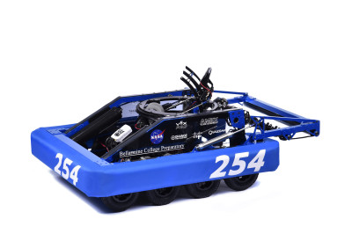
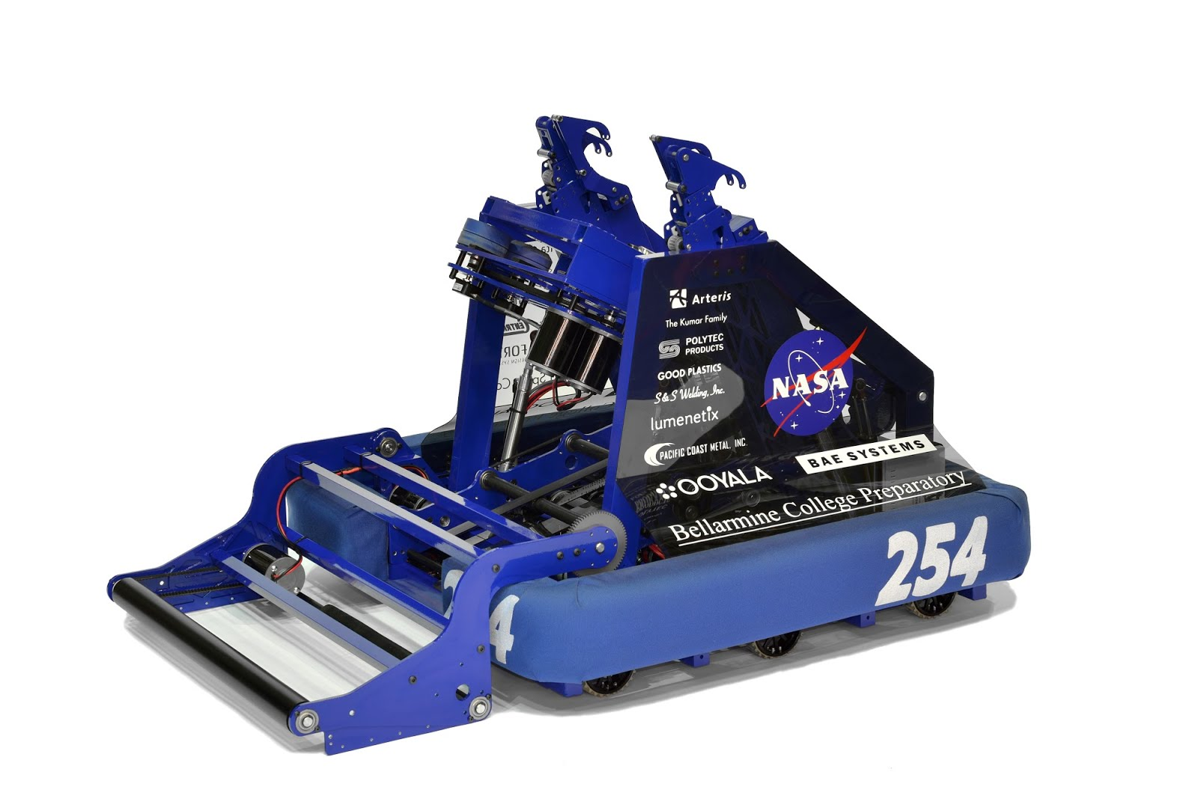
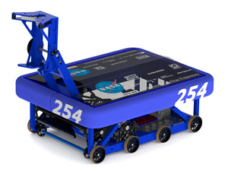
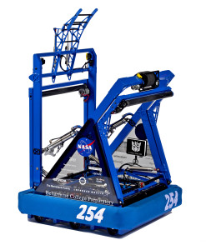
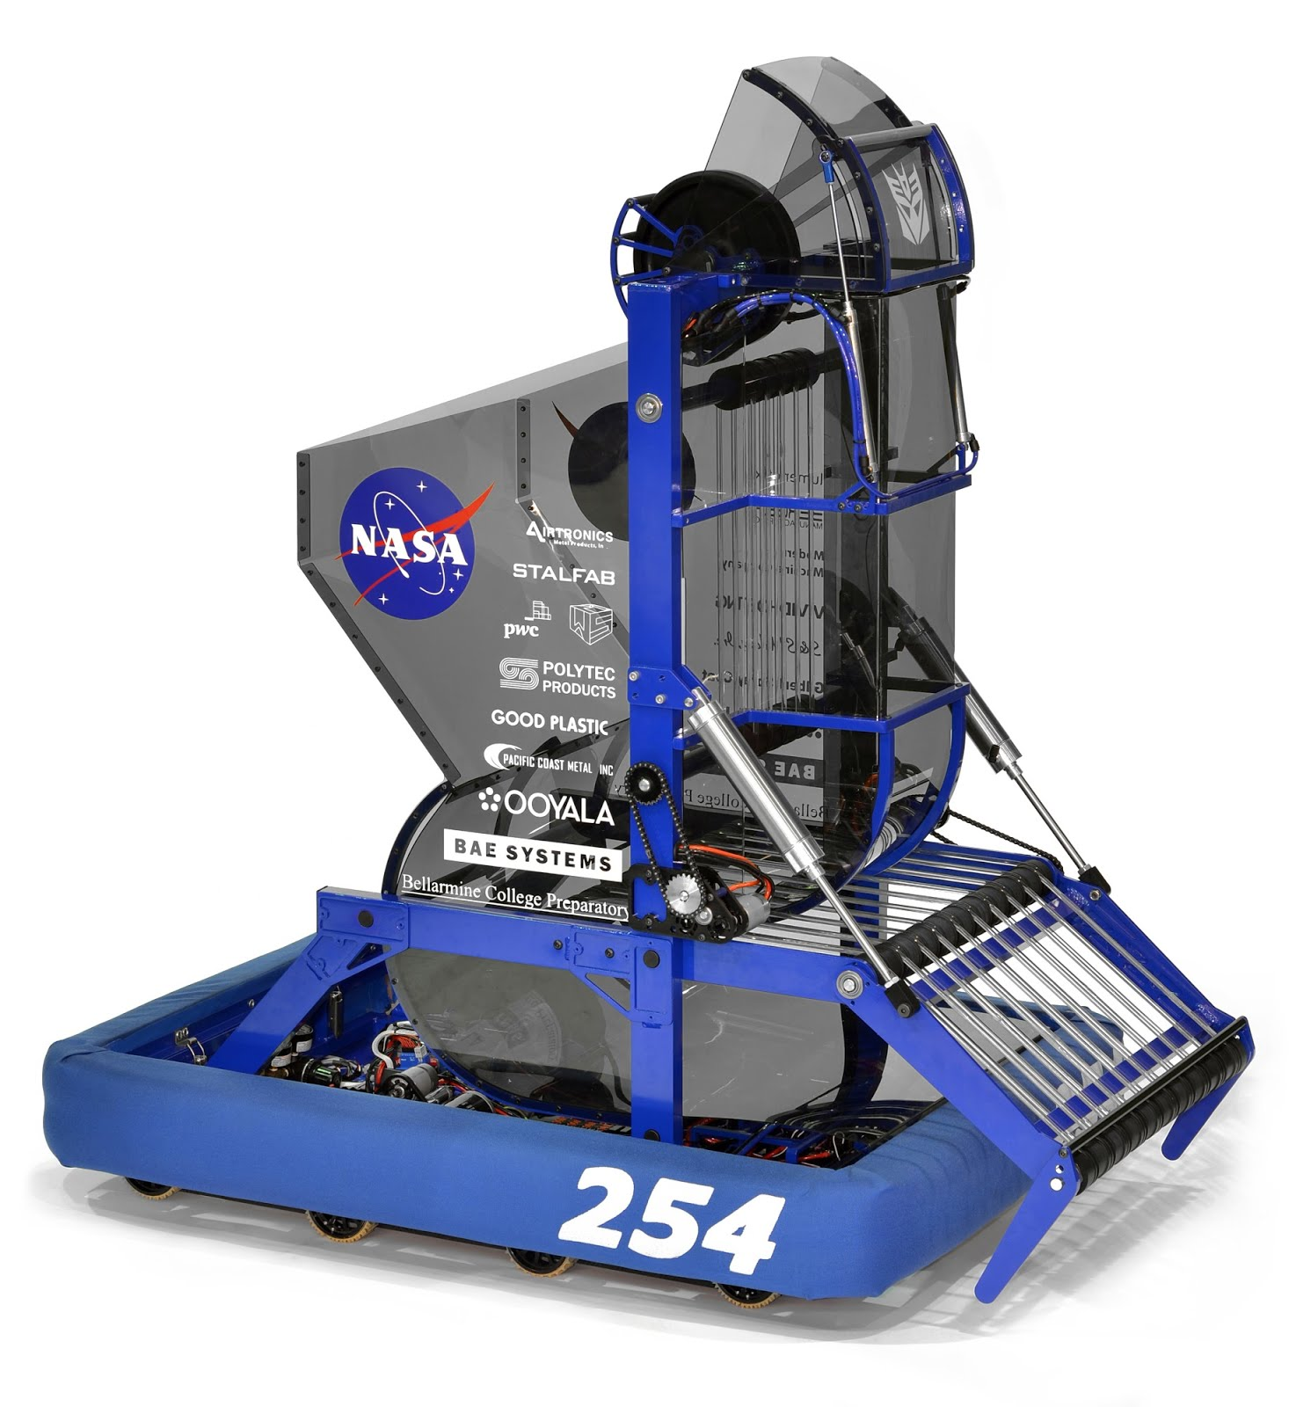
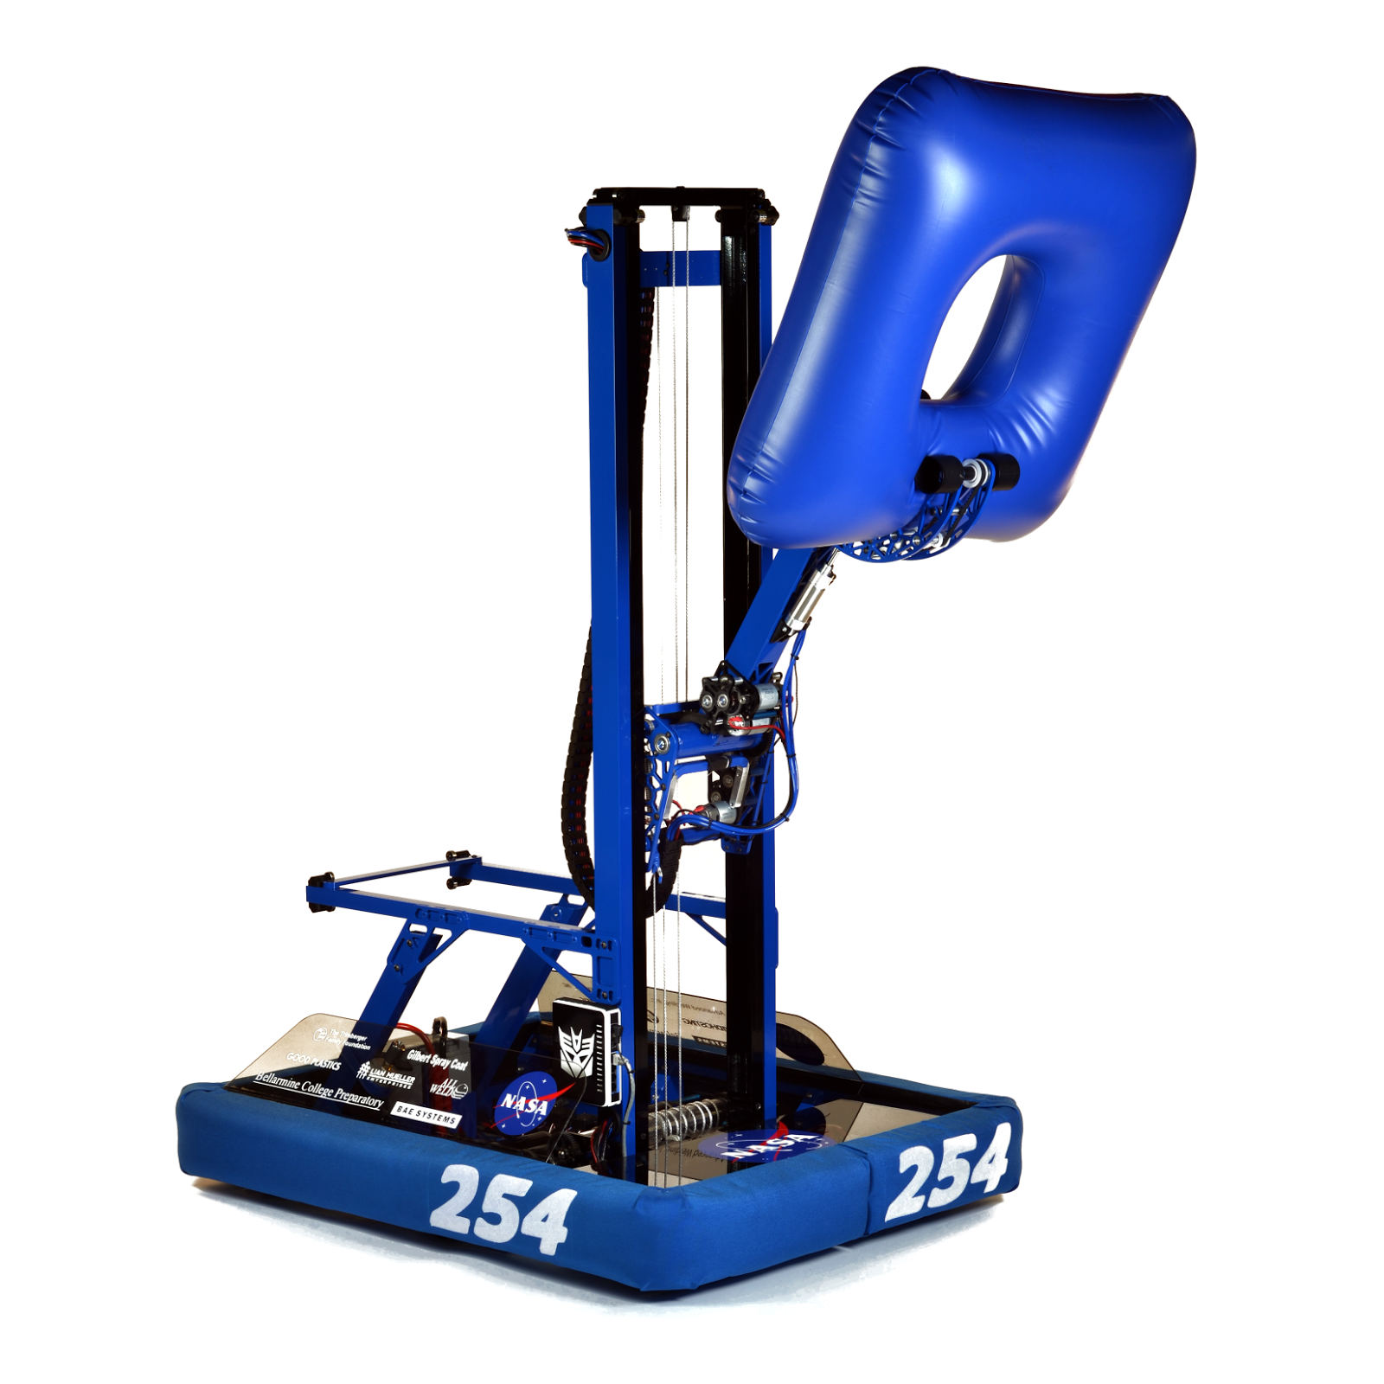
Notes:
So let’s take a look at the drive train of one of the most successful teams in FIRST, team 254 The Cheesy Poofs.
Clockwise from the top, these were the robots for 2016, 2013, 2010, 2011, 2009 and 2014.
What do you notice about each of these drive trains?
They are all either 6-wheel or 8-wheel tank drive.

Slide 12
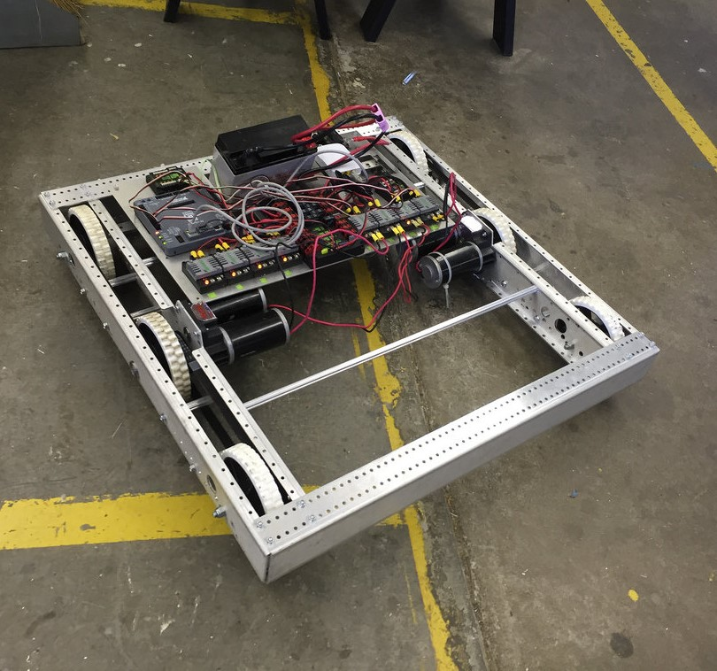
Golden Rule #3
Use A Proven (for you!) Drivetrain
Basic 4, 6, or 8-Wheel Drive
Kitbot
Swerve (COTS)
Spend Time on Mechanisms
Story of Rarecab in 2008
Notes:
So that brings us to the third golden rule.
Use a conventional 4, 6 or 8-wheel drive.
It’s been proven to work by the best teams in FIRST in every game over the past 10 years.
For a rookie team, the easiest way to do this is to build the Andy Mark Chassis that comes in the KOP
Team 1114 shows a way to build a more sophisticated Kitbot if you want to be more adventurous.
So choosing to build a straight-forward drive train will accomplsh two major goals:
It will provide you with a solid, reliable drive train
It will give you more time to focus on mechanisms

Slide 13
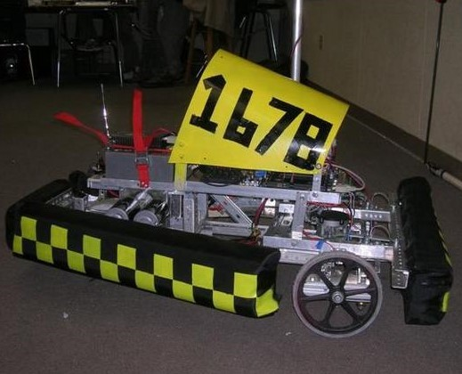
Notes:
So that brings us to the third golden rule.
Use a conventional 4, 6 or 8-wheel drive.
It’s been proven to work by the best teams in FIRST in every game over the past 10 years.
For a rookie team, the easiest way to do this is to build the Andy Mark Chassis that comes in the KOP
Team 1114 shows a way to build a more sophisticated Kitbot if you want to be more adventurous.
So choosing to build a straight-forward drive train will accomplsh two major goals:
It will provide you with a solid, reliable drive train
It will give you more time to focus on mechanisms

Slide 14
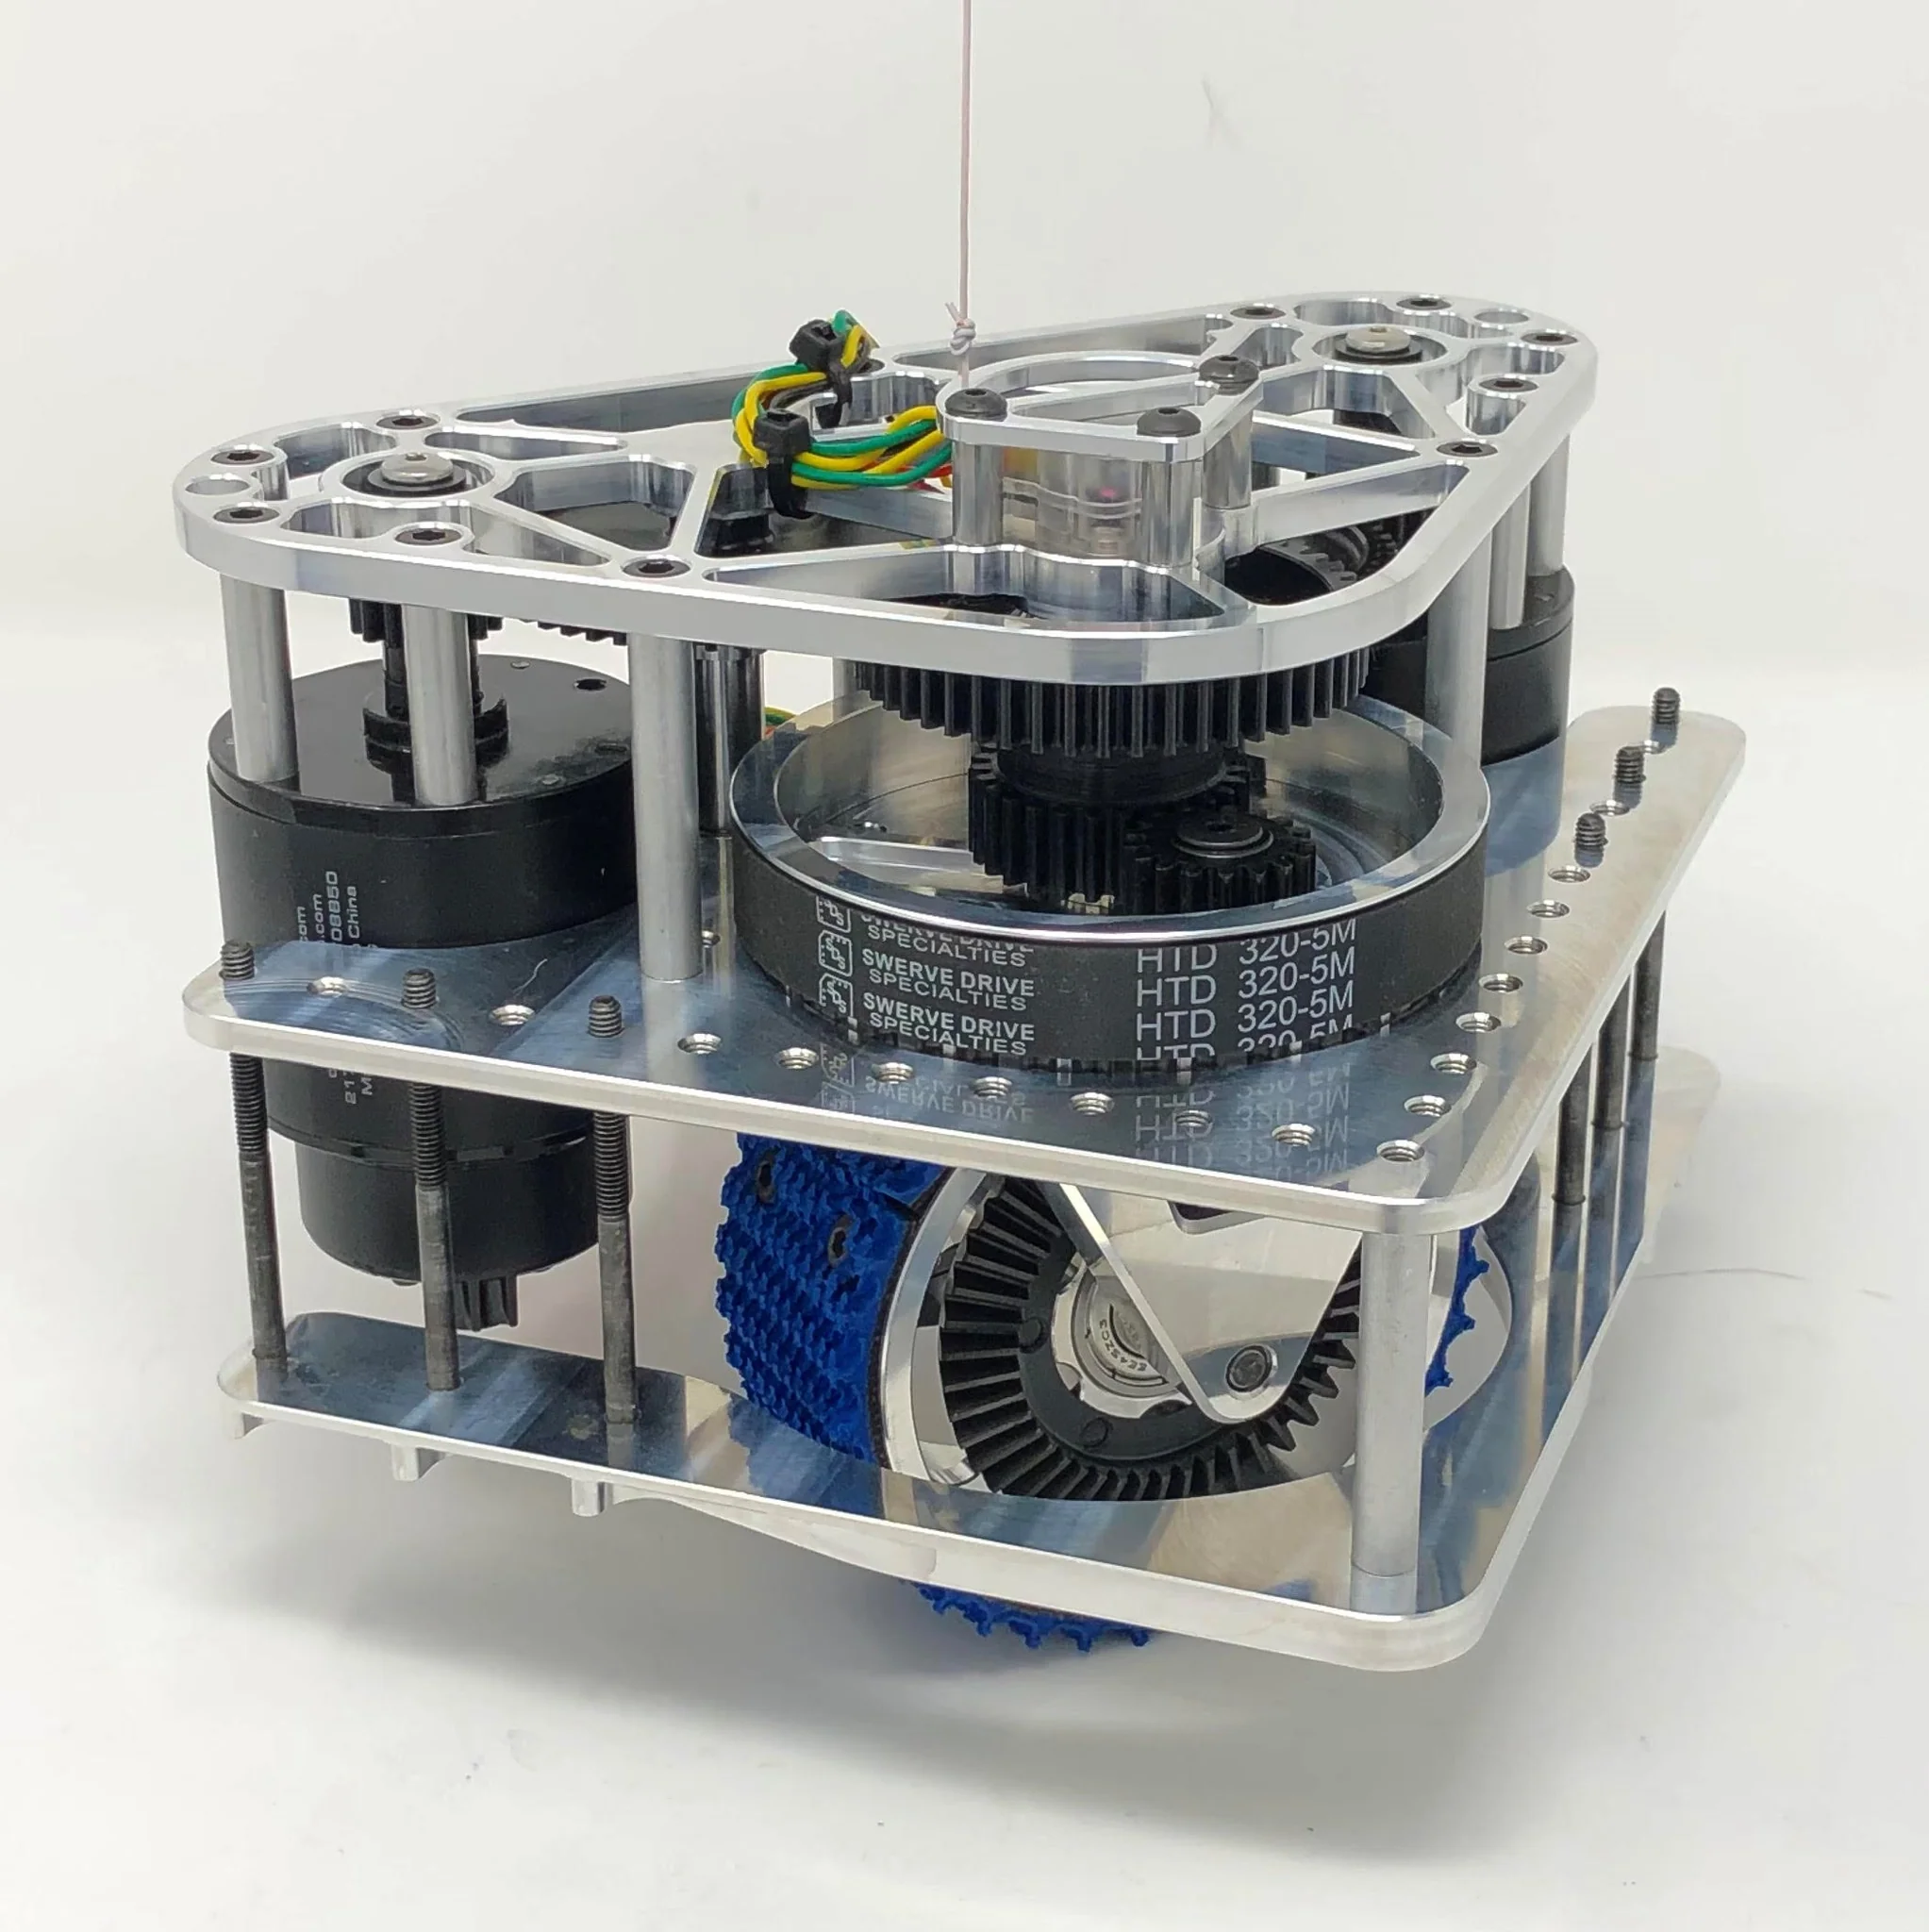
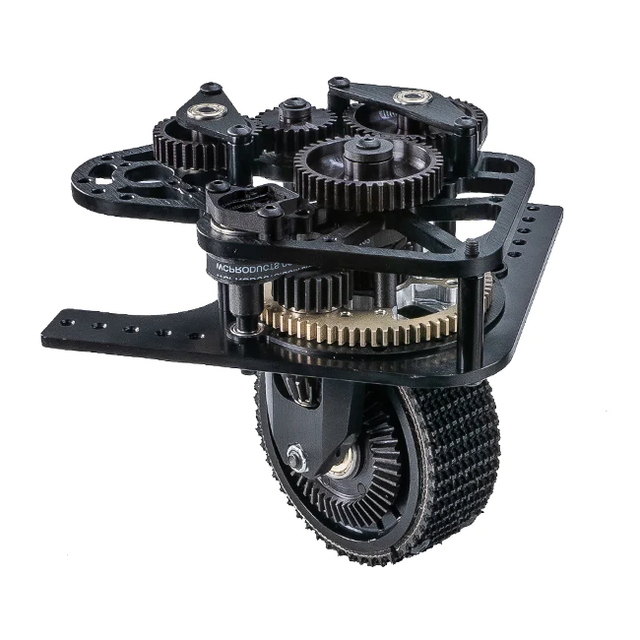
Swerve Drive
Use COTS
SDS or WCP
Build during Offseason
Programming Intensive
Get enough driver training!
Notes:
So that brings us to the third golden rule.
Use a conventional 4, 6 or 8-wheel drive.
It’s been proven to work by the best teams in FIRST in every game over the past 10 years.
For a rookie team, the easiest way to do this is to build the Andy Mark Chassis that comes in the KOP
Team 1114 shows a way to build a more sophisticated Kitbot if you want to be more adventurous.
So choosing to build a straight-forward drive train will accomplsh two major goals:
It will provide you with a solid, reliable drive train
It will give you more time to focus on mechanisms

Slide 15
Mechanism Design
Notes:
Now that we’ve established our drive base, we need to think about the mechanisms that will allow our robot to play the game
My last presentation, Build Season 101 talked about the design process and prototyping.
Here we will talk more about the specific designs.

Slide 16
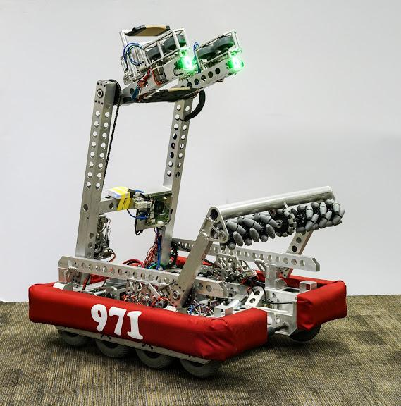
Mechanism Geometry
Minimum Degrees of Freedom
Low C.O.G. (Motors and Battery)
Symmetry When Possible
Inside Frame Perimeter If Possible
Robust When Outside Frame Perimeter
Notes:
On of the main considerations in your robot design is the mechanism geometry.
Basically this has to do with how everything will pack into the robot and how mechanisms interact with each other.
Som of the keys to consider here are:
Always think about KISAR.
Limit the degrees of freedom. It’s better to have mechanisms only moving through one plane. They are usually more stable.
Keep a low COG. Generally means placing the battery and motors as low as possible. If you need a mechanism higher up, consider driving it from a belt or chain.
Try to keep things symmetrical. For example, have an identical arm on each side of your intake mechanism.
Try to keep mechanisms within the frame perimeter so they are protected. If the do go outside, you need to make them strong enough to handle impacts.
971’s 2016 riobot is a great example of this

Slide 17
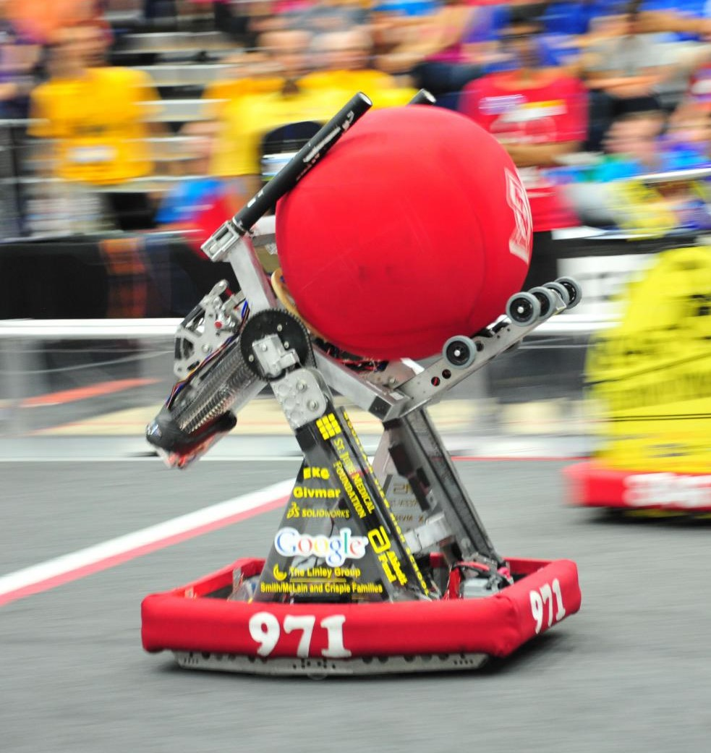
Movement - Motors
Range of Motor Choices
Single Speed or Shifting Gearboxes
Allow Variable Movement
Harder to Control (Need Sensors for precision motion)
Notes:
In first there are two basic ways to create movmement, well-three if you include stored energy.
The first is by using motors.
The advantage of using motors is that there is a wide range of choices, you can gear the motors for different torque or speed and they allow you variable movement. That is to say that you can theoretically move an object to an infinite no of positions.
This is useful, for example when you have an arm that needs to move a game object to lots of different positions like the 971 robot, Mammoth in the picture.
The disavdantage of motors is that they are harder to control, usually require sensors and can be heavy.

Slide 18
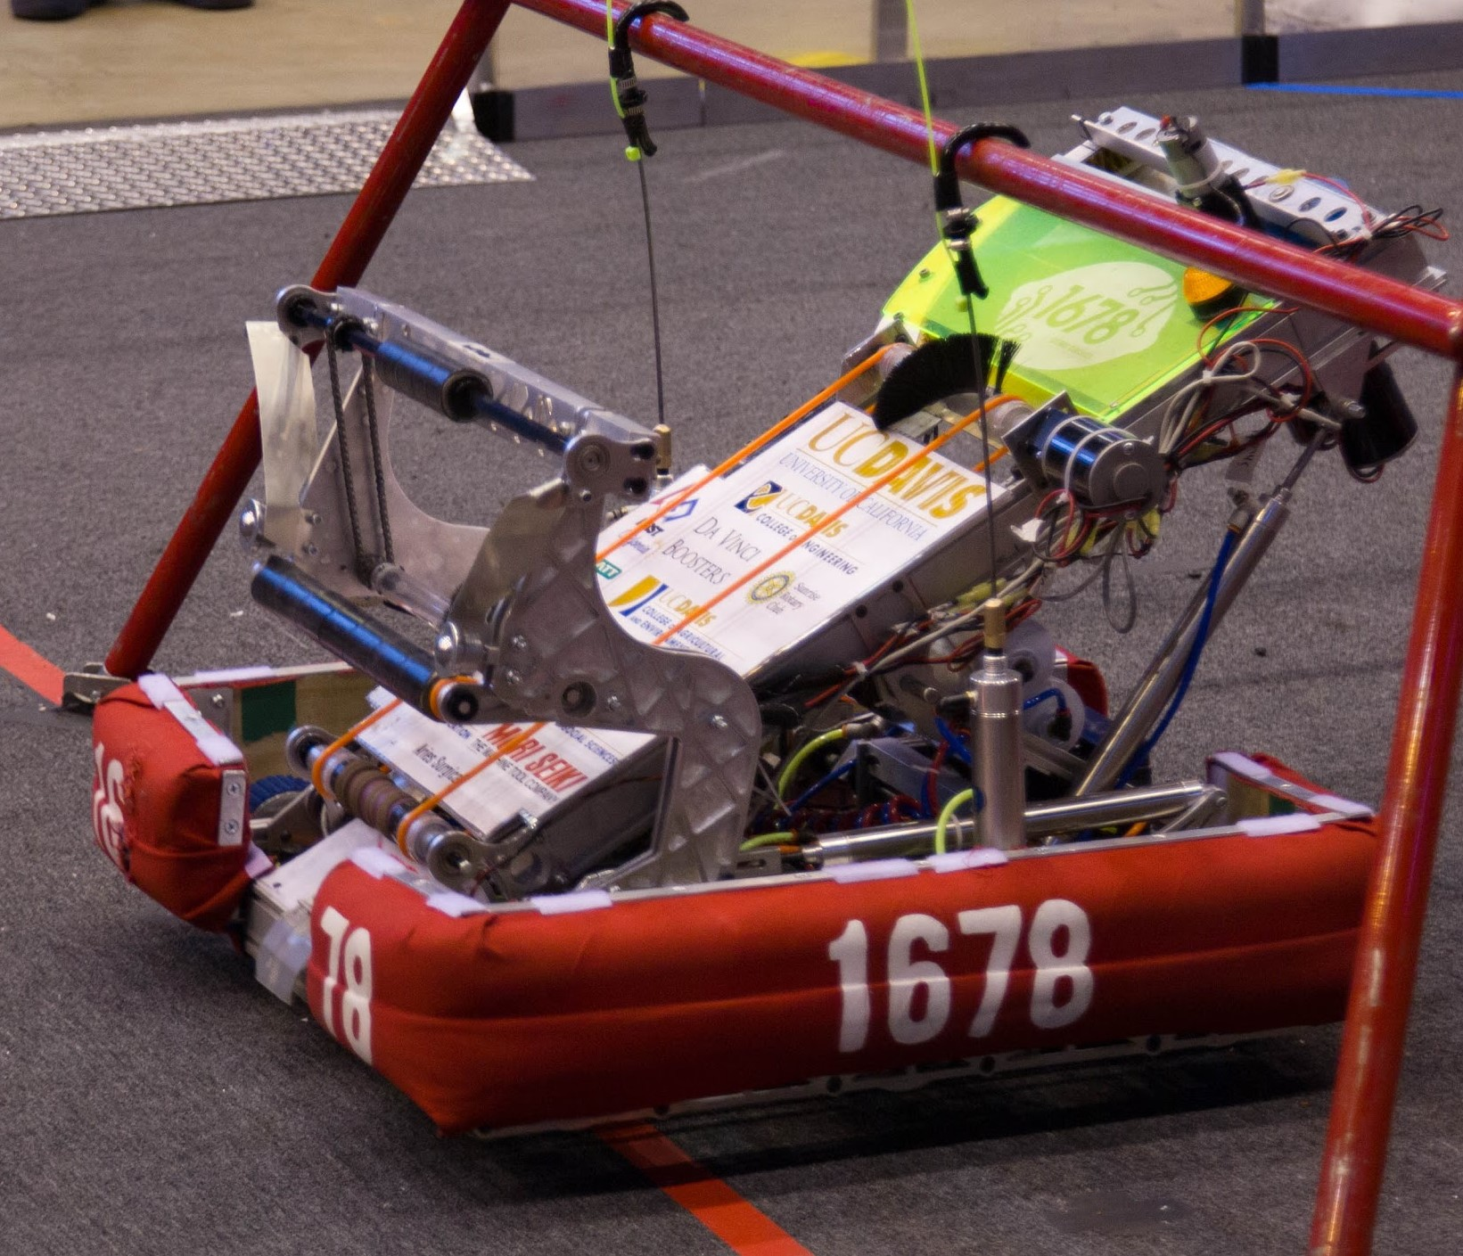
Movement - Pneumatics
Movement From Point A to Point B
Very Repeatable and Precise
Non-Variable
Requires Compressor and/or Storage
Usually lighter than motors
Be careful, can run out of air!
Notes:
The second way to create movement is using pneumatics.
A pneumatic cylinder goes from Point A to Point B with a very precise and repeatable movement.
This is very useful if you have mechanisms that only need to have two positions.
This is 1678’s robot in 2013. Pneumatics on the intake, elevator position and hanger.
Main advantage is weight but they do require either an on-board compressor of sufficient air tanks to complete all the needed cycles.

Slide 19
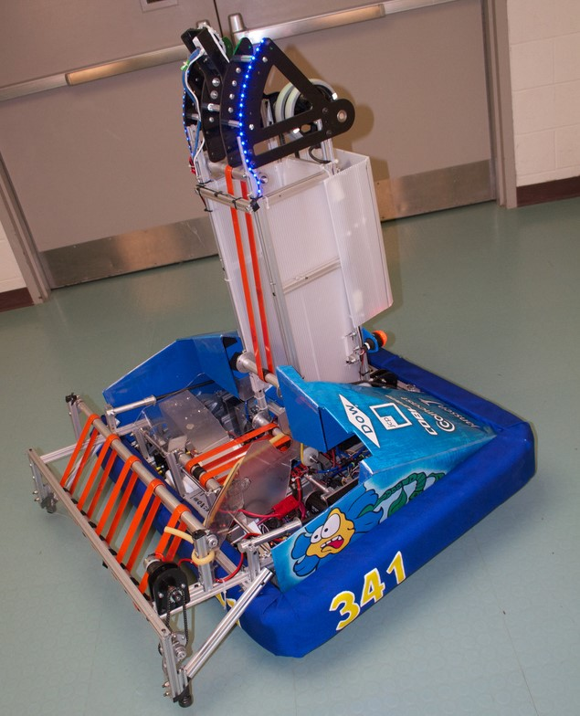
Acquisition Zone
Effective Intake Area
Object/Intake Interaction
Make the Driver’s Job Easy
Stress The Prototype
Notes:
In terms of acquiring the game object, a kay thing to think about is the acquisition zone.
This is the effective size or area of interaction with the game object.
Basically, the larger the acquisition zone, the easier it will be for the driver.
So when you are designing and prototyping intake mechanisms, do two main things:
Try to make the acquisition zone as large as possible.
Stress the prototype to see what are it’t limits.
The goal is to make the intake function under all conceiveable conditions.
The picture shows team 341’s robot in 2012 where many teams figured out the best way to take in balls was over the bumper allowing a very wide acquisition zone.
You’ll notice that the robot is using an active mechanism that sucks the ball into the intake as soon as it touches any part of the mechanism. This rings us to the fourth golden rule:

Slide 20
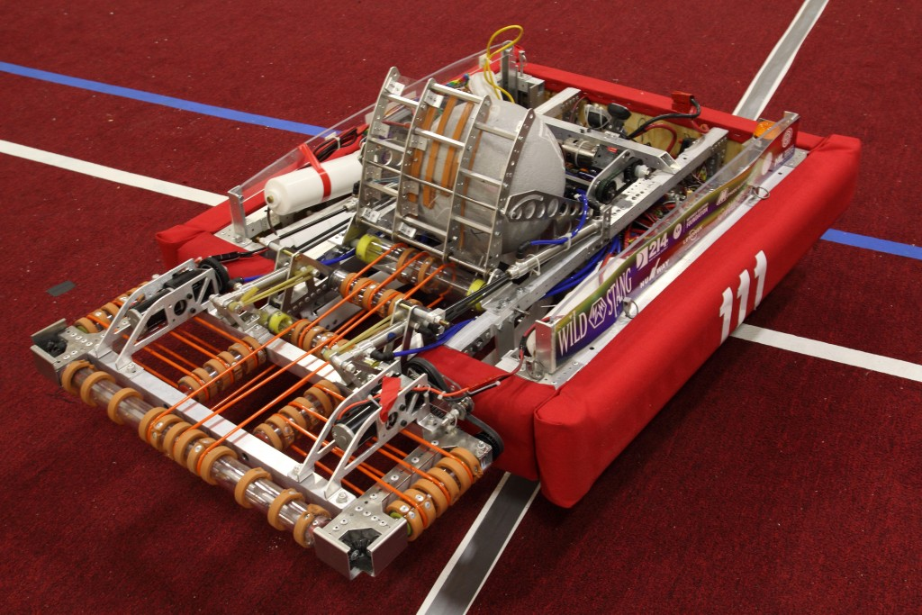
Golden Rule #4
Rolly-Grabbers
Continuous Intake
Increases Acquisition Zone
Compare to Single Intake (claw, hook, scoop)
Notes:
In FIRST, we like to call these mechanisms Rolly-Grabbers.
It’s basically a continuous intake system that will keep sucking in game objects as long as they come in contact with the mechanism.
This compared to a single intake system such as a claw, hook or scoop.
Having the rolly-grabber out front on the intake essentially increases the acquisition zone.
Let’s look at some examples:

Slide 21
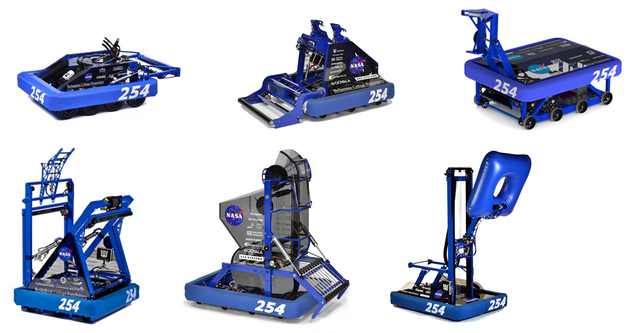
Notes:
We’re looking at the same six team 254 robots I showed for the drivetrain deisgn.
Notice that every single robot has a rolly-grabber.on the intake.

Slide 22
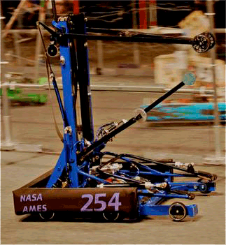
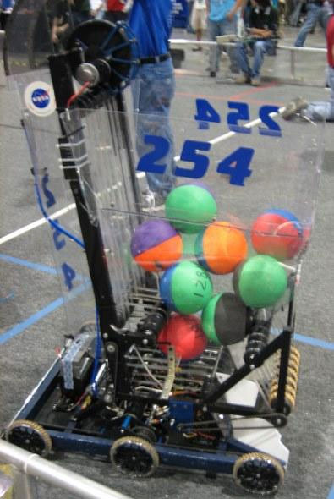
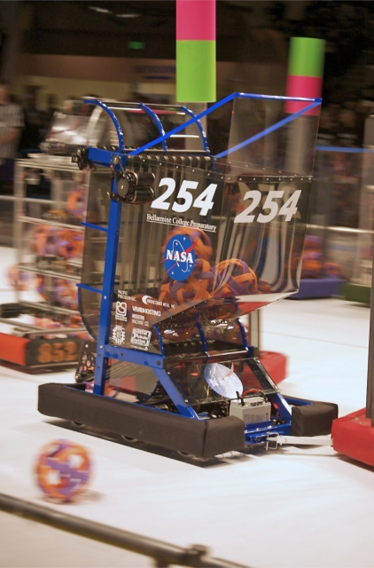
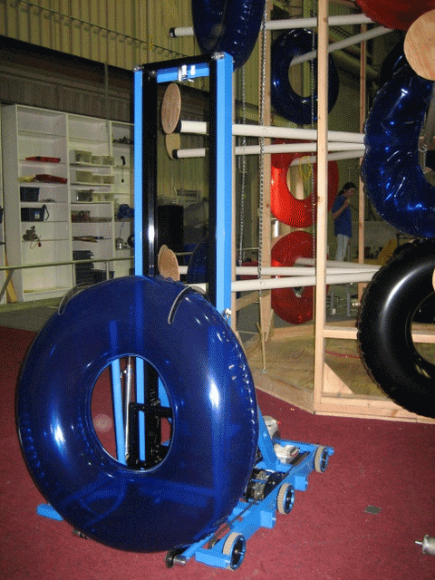
Notes:
This is an example of a rolly-grabber intake from last year.
Note the size of the acqusition zone.

Slide 23
Electrical, Pneumatics and Programming
Notes:
So we’ve looked at some key points about drivetrain and mechanism design but let’s now take a look at what are often the most fragile components of the robot: The electronics and pneumatics.

Slide 24
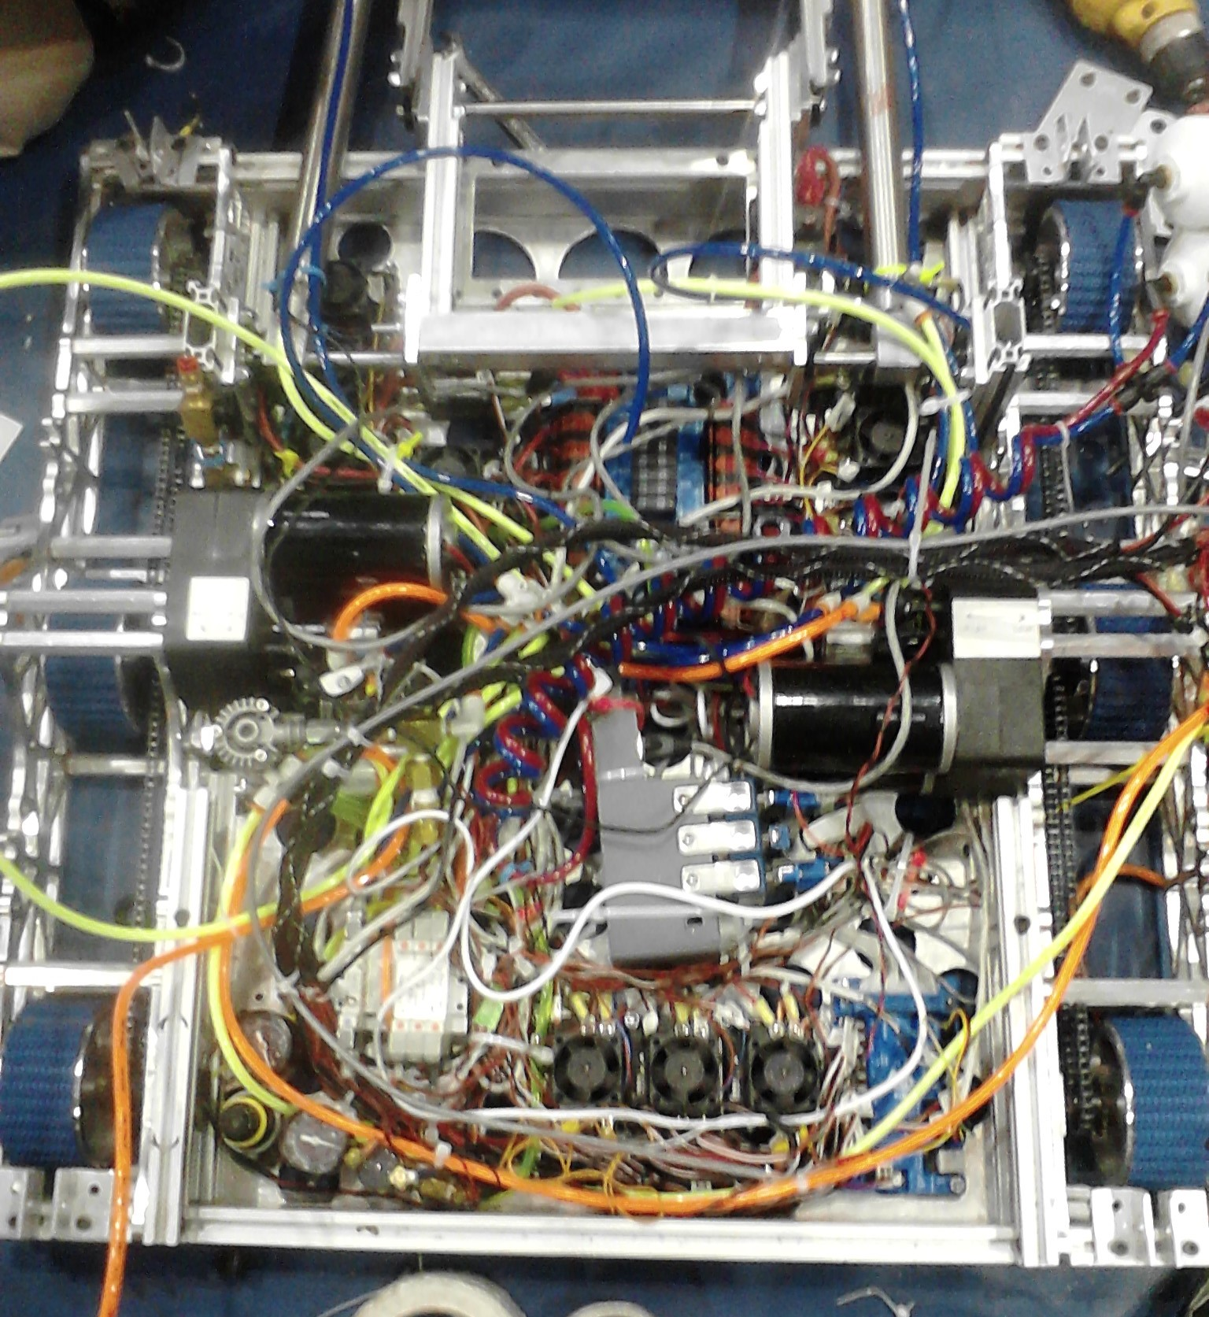
Electrical and Pneumatics
So Much Can Go Wrong (Power, Signal, Radio, Leaks, etc)
Spend time to do it right
1678 On Einstein in 2013
1678 2019
Notes:
Electronics and pnematics are the life blood of your robot. Without them, your robot will not function.
How many electrical connections do you think there are on a typical FRC robot.
On our 2016 robot, there are 38 connections (19 positive and 19 negative) to the power distribution board (40 if you include the two battery cables) so that means there are a total 76 electrical connections, considering both ends of each of those wires. This doesn’t include the connections between the speed controllers and the motors or all of the signal wires.
The fact is that if any one of these becomes disconnected in a match, it cause the robot to be inoperable.
In 2013, in our first semi-final match on Einstein put up the high score of 233 points. We then lost the second semi-final because our robot died halfway through the match. When we got badk to the pits we discovered we had not secured our compressor to the chassis, it had come loose and pulled out the power connector to the radio so we lost connection.
With mechanical parts of your robot, it’s easy to see things that are broken.
But with electronics it is difficult to actually see a bad connection.
So what do we do? What you don’t do is follow our example as in the picture. This is the wiring on our 2013 robot.

Slide 25
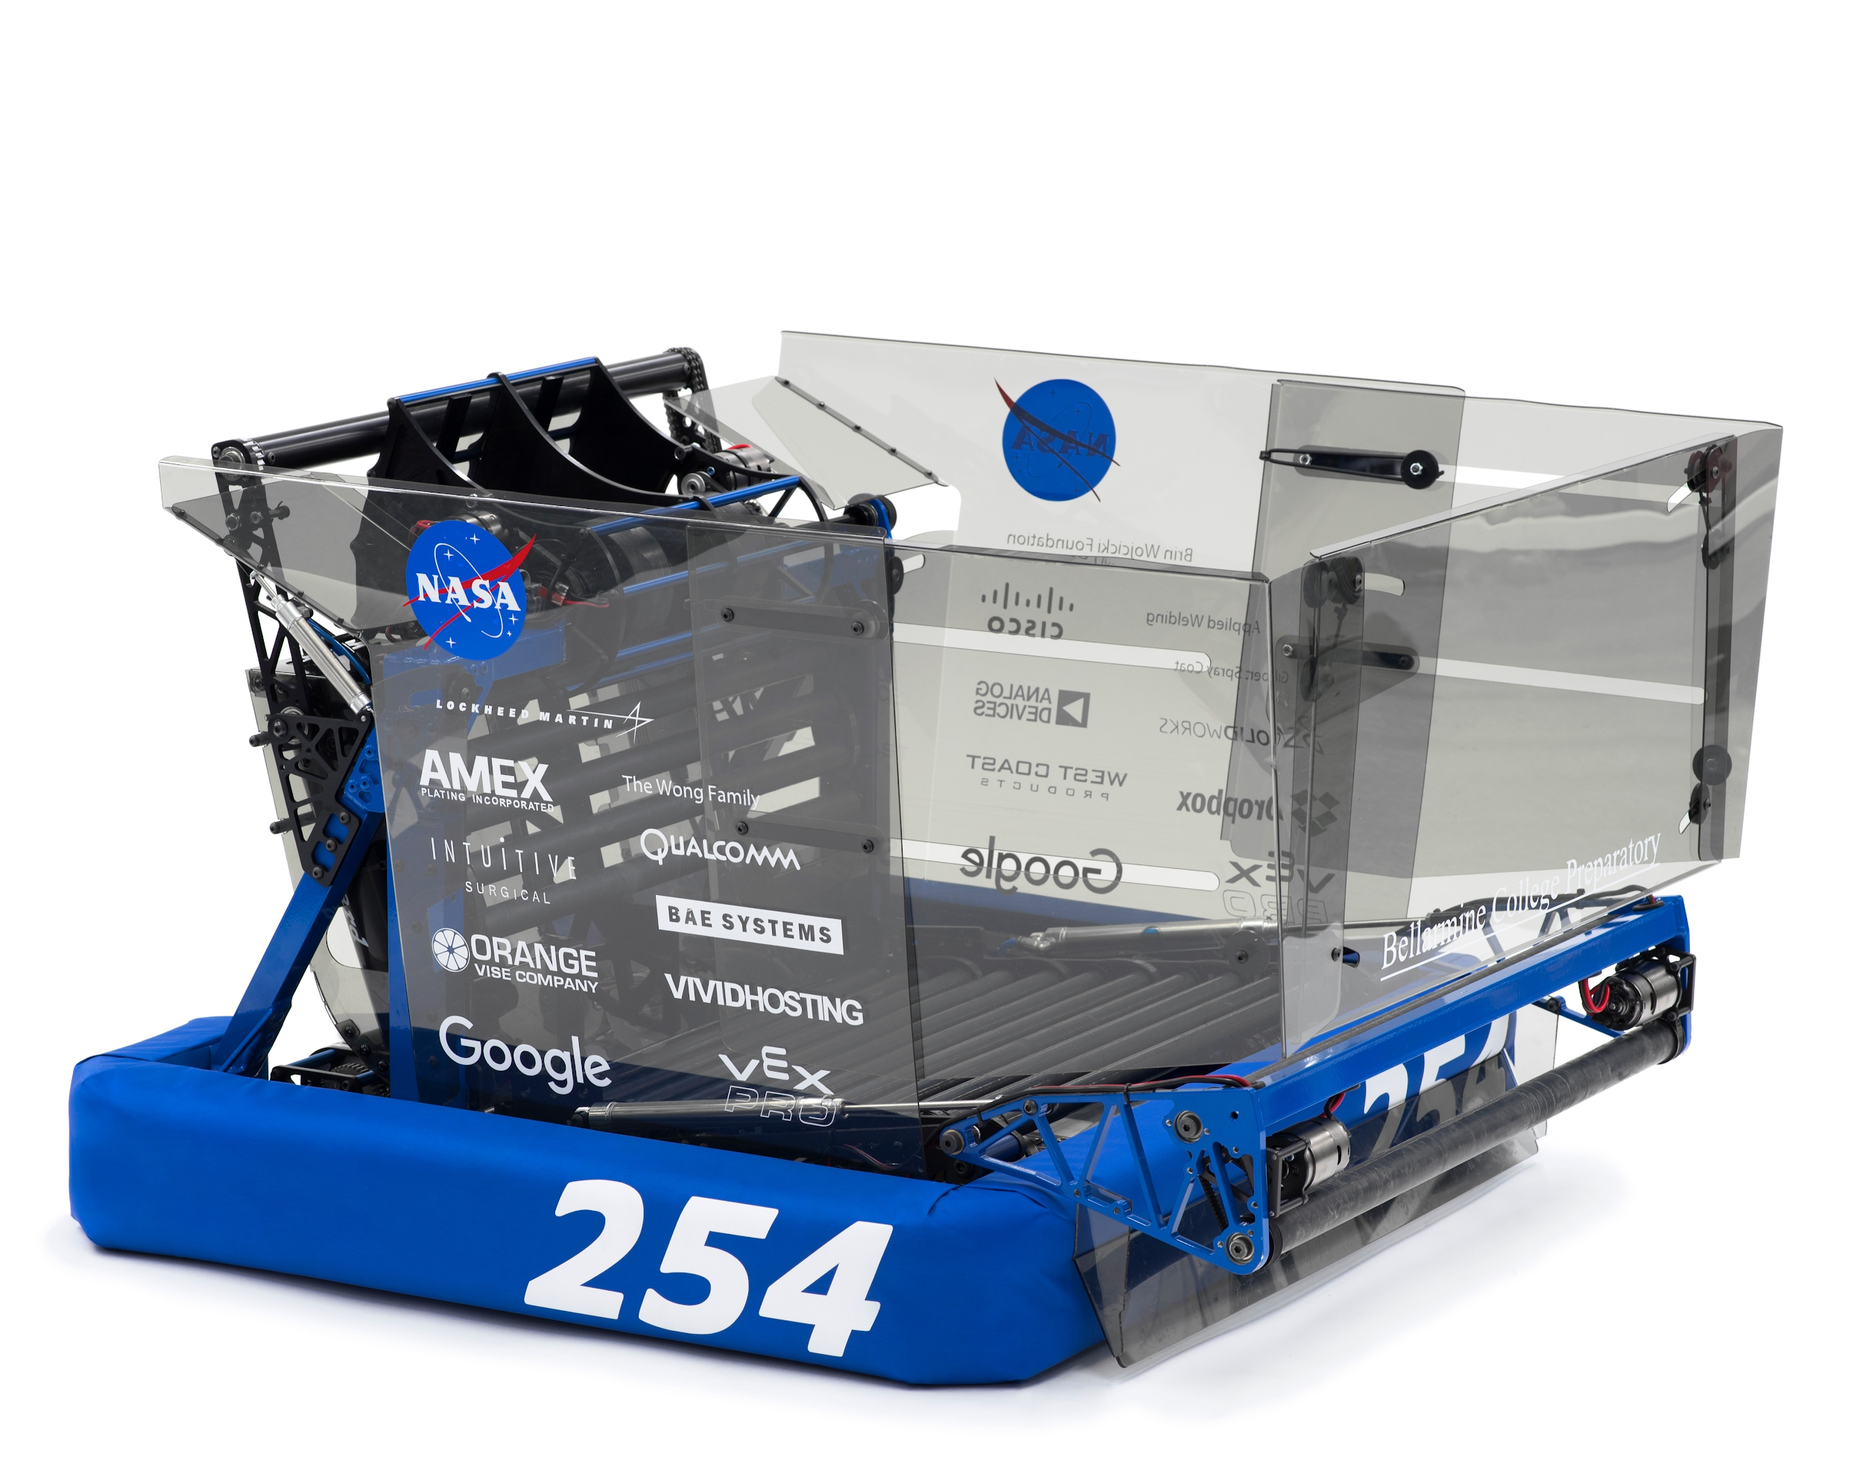
Programming “Toolkit”
Precision Autonomous Driving
Using encoders + gyro
Vision Alignment
Limelight
PID for arms and elevators
Talon + Mag Encoder
Bang Bang controller for Shooter
Talon + Mag Encoder
Notes:
Just as

Slide 26
Build Season

Slide 27
Build Season Overview
Accelerated Schedule is Important
When setting schedule: “Aim for the Moon, Land among the Stars”
Students ALWAYS assume there is more time than there is
Often, Mentors do too!
Notes:
Slap it on anything you want your team to be associated with
Easy recognition
same logo for many years -> has developed into recognizable icon
Consistent!
Protect your logo from manipulation and distortion! (i.e. scalability)
Variants for different situations
Don’t change every year - lose your identity
If you are changing, it’s a big deal! Be decisive and stick to your change
Logo, colors, fonts
Pick a few out and stick with them! Remember the RGB/CMYK/HEX codes on reference sheet

Slide 28
Brainstorming
Most important weekend of your entire season
Three Steps (in this order!)
Read the Rules
Answer the “What” Questions
What is our strategy? What will the robot do?
Answer the “How” Questions
How will the robot carry out this function?
Notes:
Slap it on anything you want your team to be associated with
Easy recognition
same logo for many years -> has developed into recognizable icon
Consistent!
Protect your logo from manipulation and distortion! (i.e. scalability)
Variants for different situations
Don’t change every year - lose your identity
If you are changing, it’s a big deal! Be decisive and stick to your change
Logo, colors, fonts
Pick a few out and stick with them! Remember the RGB/CMYK/HEX codes on reference sheet

Slide 29
The “Whats”
What are the ways to score?
What is each task worth (Points/RP)?
What is the difficulty of the task?
In game
To build during build season
Design Points
Specialization is a goal not compromise!
Just because another team is doing it, doesn’t mean you should.
Notes:
Slap it on anything you want your team to be associated with
Easy recognition
same logo for many years -> has developed into recognizable icon
Consistent!
Protect your logo from manipulation and distortion! (i.e. scalability)
Variants for different situations
Don’t change every year - lose your identity
If you are changing, it’s a big deal! Be decisive and stick to your change
Logo, colors, fonts
Pick a few out and stick with them! Remember the RGB/CMYK/HEX codes on reference sheet

Slide 30
The “Hows”
How will the robot carry out this function?
Do you have experience with a design like this?
Passive vs Active
Processing a game piece
Typically through hand drawings.
No need to make it complicated.
Show basic mechanism ideas with correct scale.
Notes:
Slap it on anything you want your team to be associated with
Easy recognition
same logo for many years -> has developed into recognizable icon
Consistent!
Protect your logo from manipulation and distortion! (i.e. scalability)
Variants for different situations
Don’t change every year - lose your identity
If you are changing, it’s a big deal! Be decisive and stick to your change
Logo, colors, fonts
Pick a few out and stick with them! Remember the RGB/CMYK/HEX codes on reference sheet

Slide 31
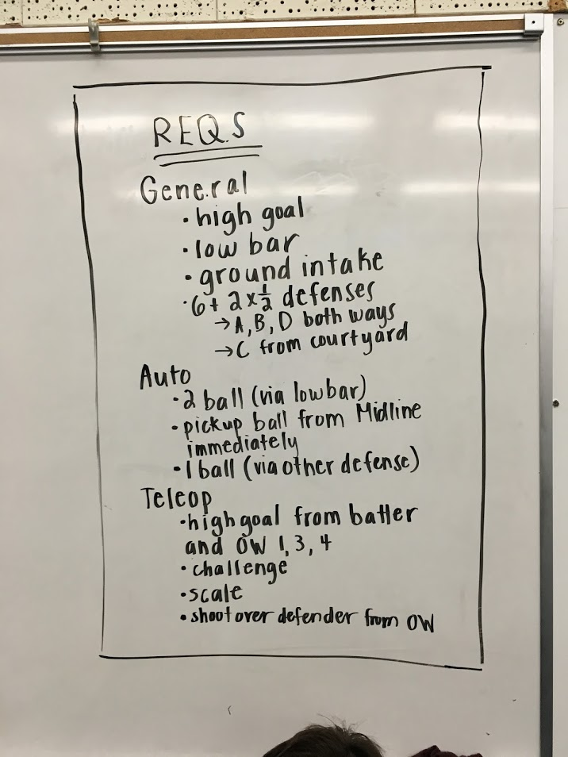
Week 1
Days 1 – 3
Brainstorming
Days 3 – 14
Prototyping Mechanisms
Drive-base electrical layout
Fabricate/Assemble Drivetrain
Begin writing code for expected mechanisms
Assemble Alpha Robot
Notes:
Slap it on anything you want your team to be associated with
Easy recognition
same logo for many years -> has developed into recognizable icon
Consistent!
Protect your logo from manipulation and distortion! (i.e. scalability)
Variants for different situations
Don’t change every year - lose your identity
If you are changing, it’s a big deal! Be decisive and stick to your change
Logo, colors, fonts
Pick a few out and stick with them! Remember the RGB/CMYK/HEX codes on reference sheet

Slide 32
Week 1
Days 1 – 3
Brainstorming
Day 3
Design Drivetrain
Days 4 – 14
Prototyping Mechanisms
Drive-base electrical layout
Fabricate/Assemble Drivetrain
Begin writing code for expected mechanisms
Notes:
Slap it on anything you want your team to be associated with
Easy recognition
same logo for many years -> has developed into recognizable icon
Consistent!
Protect your logo from manipulation and distortion! (i.e. scalability)
Variants for different situations
Don’t change every year - lose your identity
If you are changing, it’s a big deal! Be decisive and stick to your change
Logo, colors, fonts
Pick a few out and stick with them! Remember the RGB/CMYK/HEX codes on reference sheet

Slide 33
Day 14
Finish Alpha Robot
Days 8 – 21
Build Mechanisms
Program Mechanisms
Days 22-28
Mechanism Integration/Wiring
Test code with assembled robot
Notes:
Slap it on anything you want your team to be associated with
Easy recognition
same logo for many years -> has developed into recognizable icon
Consistent!
Protect your logo from manipulation and distortion! (i.e. scalability)
Variants for different situations
Don’t change every year - lose your identity
If you are changing, it’s a big deal! Be decisive and stick to your change
Logo, colors, fonts
Pick a few out and stick with them! Remember the RGB/CMYK/HEX codes on reference sheet

Slide 34
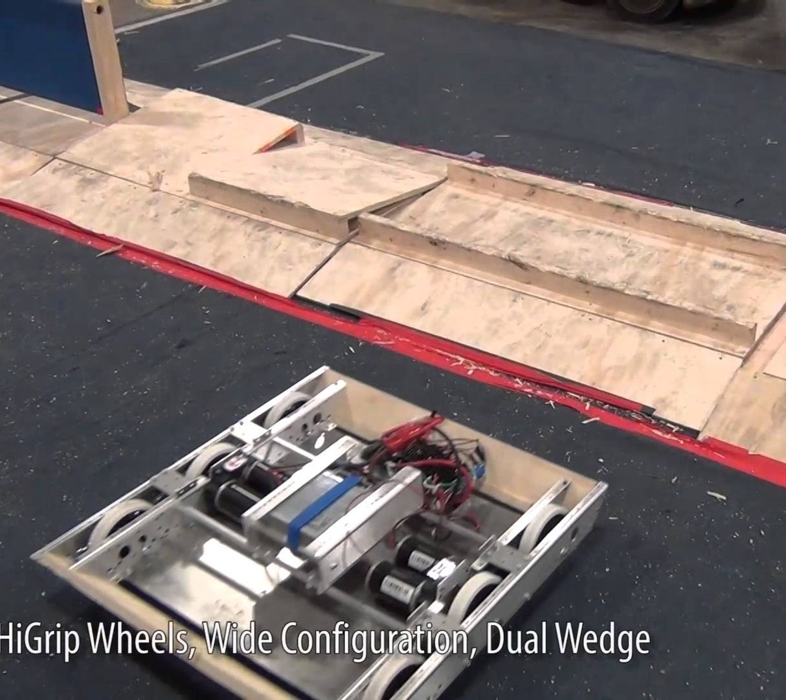
Golden Rule #5
Day 29
Robot “finished”
Days 29 – 45
Testing, BREAKING, fixing, iterating
#5: Fail Faster!
Driver Practice
A Good Driver Beats a Good Robot
Notes:
Slap it on anything you want your team to be associated with
Easy recognition
same logo for many years -> has developed into recognizable icon
Consistent!
Protect your logo from manipulation and distortion! (i.e. scalability)
Variants for different situations
Don’t change every year - lose your identity
If you are changing, it’s a big deal! Be decisive and stick to your change
Logo, colors, fonts
Pick a few out and stick with them! Remember the RGB/CMYK/HEX codes on reference sheet

Slide 35
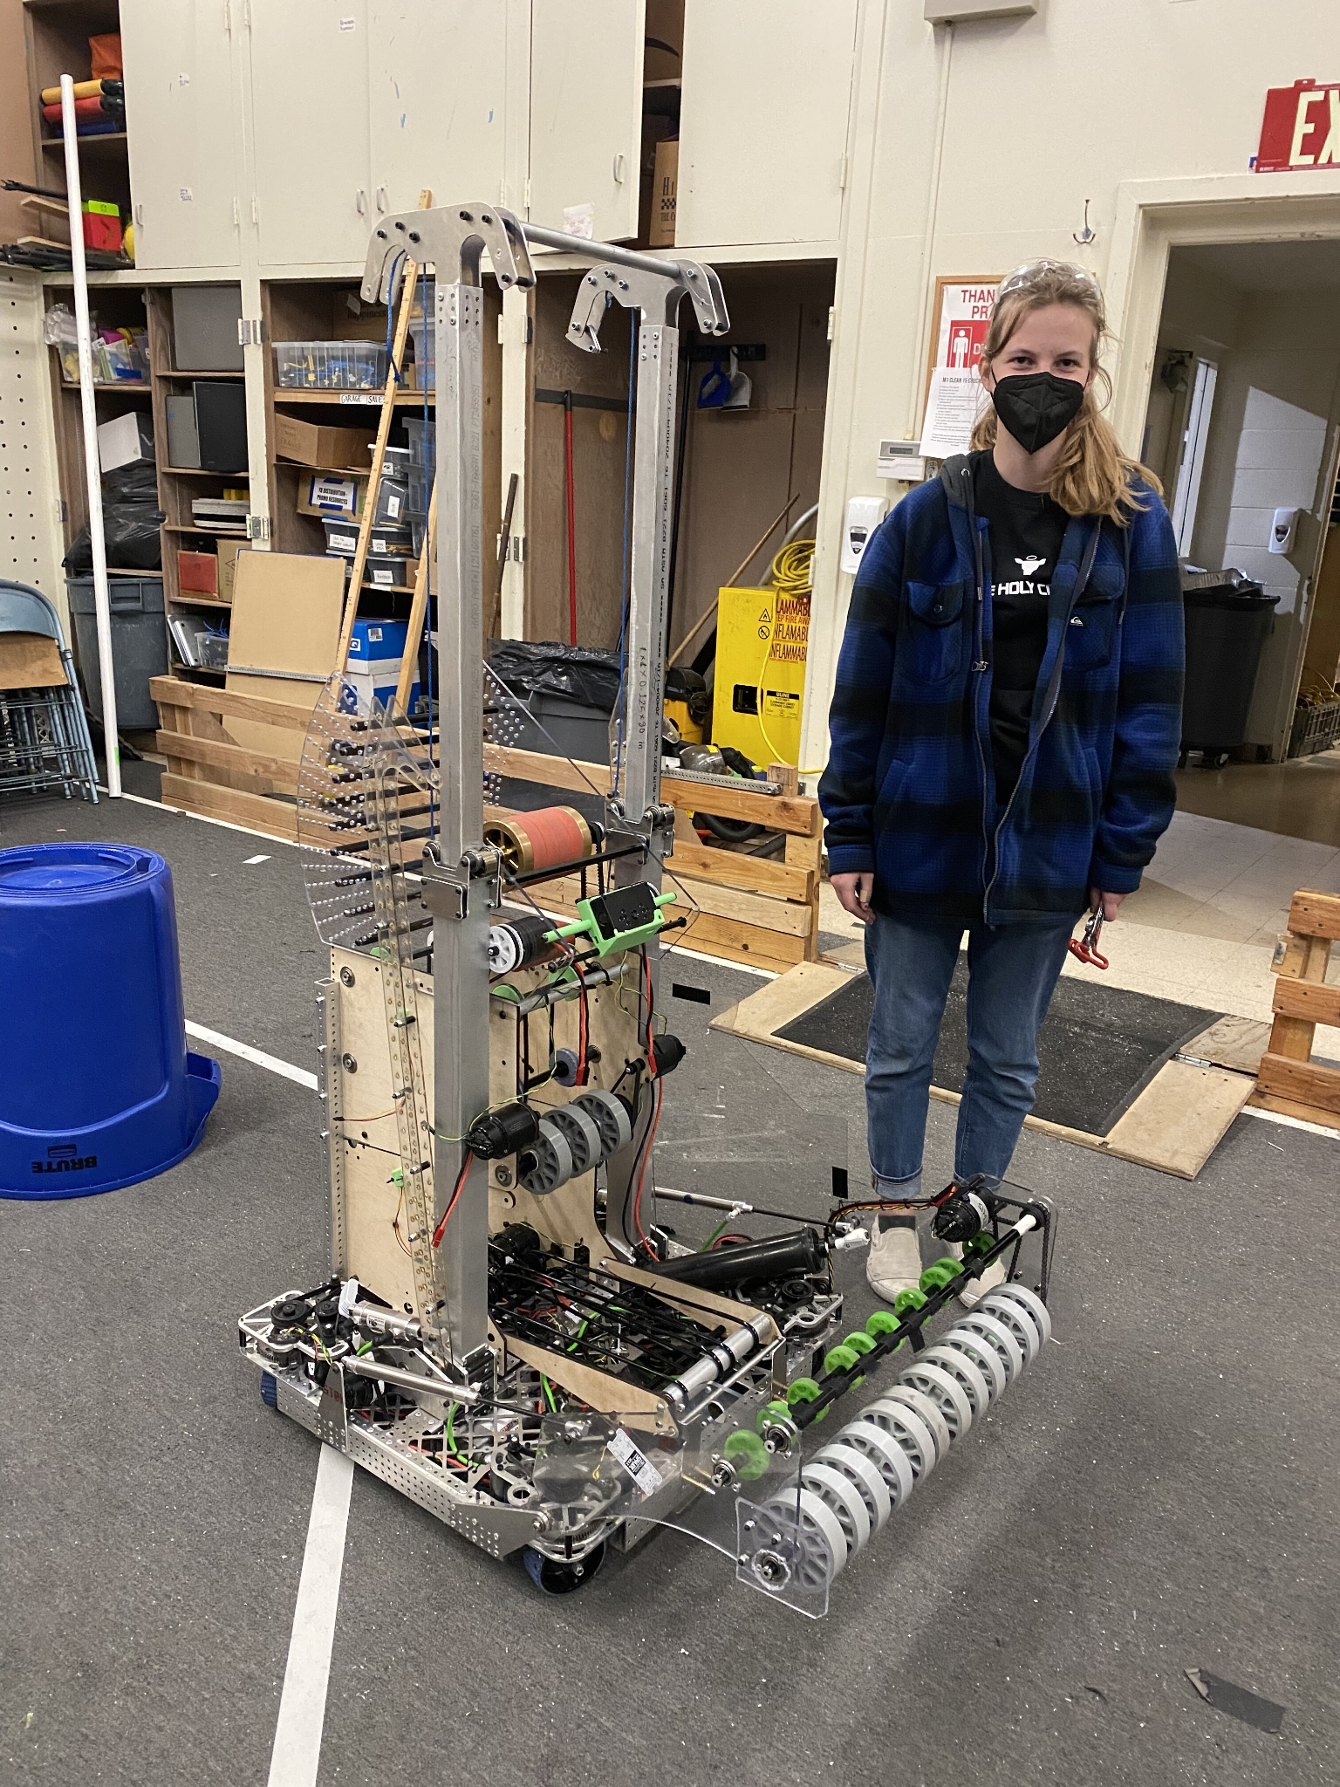
Citrus Twist - Alpha Build
Starting in 2022, we built a functional prototype that we called “Alpha”
Not Competition Legal
Alpha taught us many things like:
What auto paths would work
Early software and driver practice
Start to understand game nuance
Viability of prototypes
Notes:
Slap it on anything you want your team to be associated with
Easy recognition
same logo for many years -> has developed into recognizable icon
Consistent!
Protect your logo from manipulation and distortion! (i.e. scalability)
Variants for different situations
Don’t change every year - lose your identity
If you are changing, it’s a big deal! Be decisive and stick to your change
Logo, colors, fonts
Pick a few out and stick with them! Remember the RGB/CMYK/HEX codes on reference sheet

Slide 36
Competition Season

Slide 37
Don’t Stop
Working through competition season is more important than ever!
Be careful
Keep a tight schedule
Don’t be overly ambitious
Other teams won’t stop
Notes:
Slap it on anything you want your team to be associated with
Easy recognition
same logo for many years -> has developed into recognizable icon
Consistent!
Protect your logo from manipulation and distortion! (i.e. scalability)
Variants for different situations
Don’t change every year - lose your identity
If you are changing, it’s a big deal! Be decisive and stick to your change
Logo, colors, fonts
Pick a few out and stick with them! Remember the RGB/CMYK/HEX codes on reference sheet

Slide 38
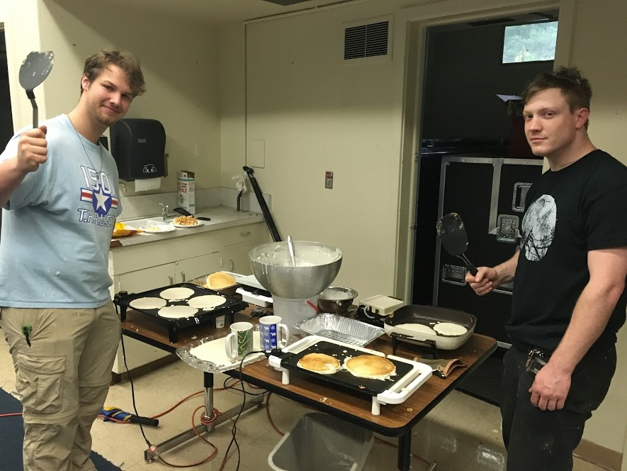
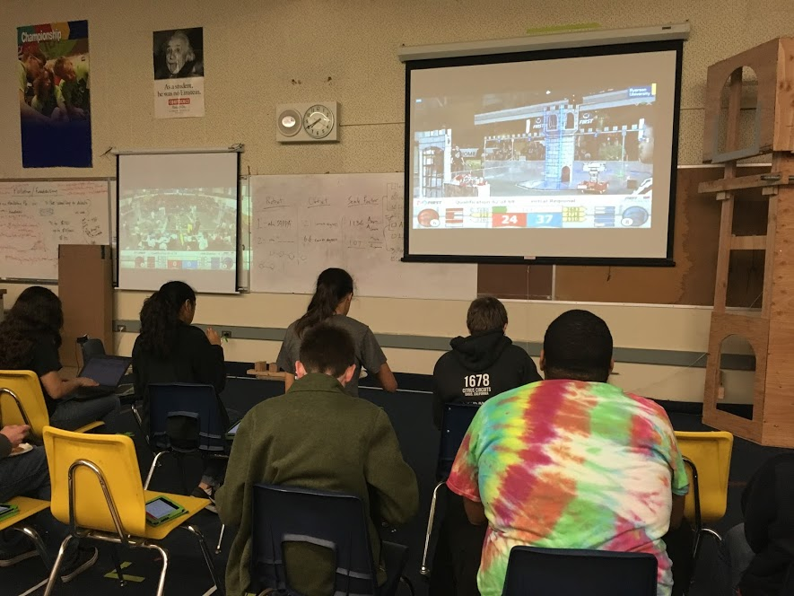
Watch Other Competitions
Watch other regionals
Webcast parties
Read Chief Delphi
Watch FUN and Gamesense
Volunteer at events
Look at other robots for ideas
Notes:
Slap it on anything you want your team to be associated with
Easy recognition
same logo for many years -> has developed into recognizable icon
Consistent!
Protect your logo from manipulation and distortion! (i.e. scalability)
Variants for different situations
Don’t change every year - lose your identity
If you are changing, it’s a big deal! Be decisive and stick to your change
Logo, colors, fonts
Pick a few out and stick with them! Remember the RGB/CMYK/HEX codes on reference sheet

Slide 39
Summary
Pre-Season Prep – Golden Rules #1 and #2
Drivetrain Design – Golden Rule #3
Mechanism Design – Golden Rule #4
Electrical and Pneumatics – Keep It Neat
Build Season – Golden Rule #5
Competition Season – Time to Improve
Notes:
Slap it on anything you want your team to be associated with
Easy recognition
same logo for many years -> has developed into recognizable icon
Consistent!
Protect your logo from manipulation and distortion! (i.e. scalability)
Variants for different situations
Don’t change every year - lose your identity
If you are changing, it’s a big deal! Be decisive and stick to your change
Logo, colors, fonts
Pick a few out and stick with them! Remember the RGB/CMYK/HEX codes on reference sheet

Slide 40
Resources
Chief Delphi – chiefdelphi.com
TCA - thecompassalliance.org
Notes:
Slap it on anything you want your team to be associated with
Easy recognition
same logo for many years -> has developed into recognizable icon
Consistent!
Protect your logo from manipulation and distortion! (i.e. scalability)
Variants for different situations
Don’t change every year - lose your identity
If you are changing, it’s a big deal! Be decisive and stick to your change
Logo, colors, fonts
Pick a few out and stick with them! Remember the RGB/CMYK/HEX codes on reference sheet

Slide 41
Thank You! Questions?
Austin Haddox
Email: ahaddox612@gmail.com
Instagram:
@ihaddanox

Slide 42
Questions?
Give us Feedback!

